Slide 1
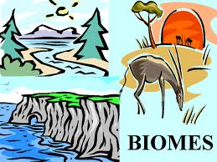
TERRESTRIAL BIOMES
Features and Creatures

Slide 2
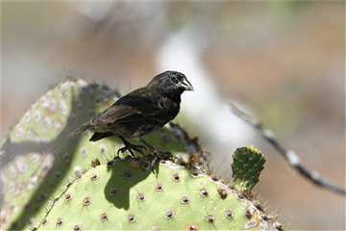
Vocabulary to Learn
Biome: areas of our planet with similar temperature, precipitation, flora (plants), and fauna (animals)
The earth has several terrestrial (land) biomes and two aquatic (water) biomes
Habitat: the general area of a biome in which a particular plant or animal species lives
Niche: the specific area of a habitat in which a particular plant or animal species lives.
Niches usually describe specific food sources and specific homes
Galapagos ground finch
What is this bird’s niche?
http://science.howstuffworks.com/life/evolution/ecological-niche.htm

Slide 3
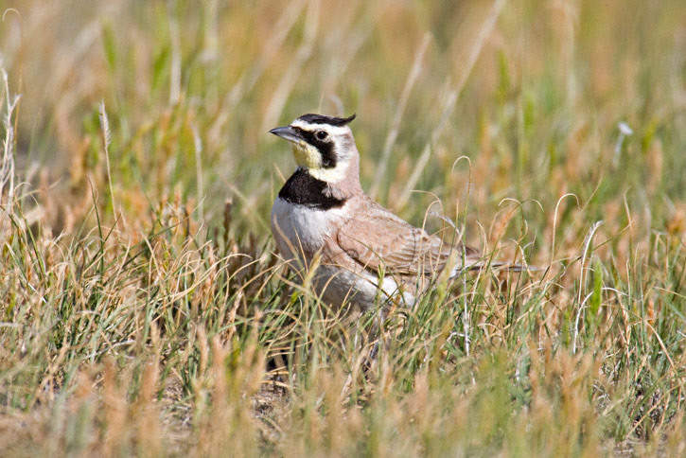
Vocabulary to Learn
The earth is divided into biomes which are divided into habitats which are divided into niches.
Example: This lark is a type of songbird. Its biome is grassland. Its habitat is open, grassy areas of grasslands. Its niche is an area of very short vegetation that produces a lot of seeds.
http://www.greglasley.net/images/H/Horned-Lark-0003-GWL-05821.jpg

Slide 4
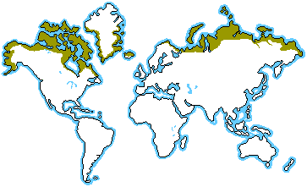
Tundra
Tundra comes from the Finnish word ‘tunturia” which means treeless plain
Location:

Slide 5
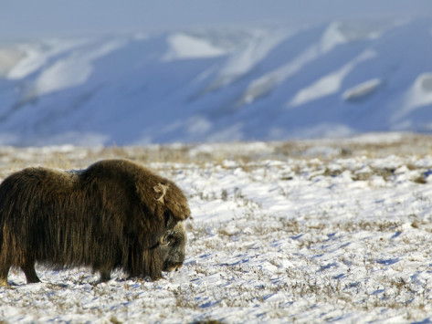
description
Cold: -40º C – 10º C (-22º F – 50º F)
Dry: 15-25 cm (6-10 in) precipitation, which falls mostly as snow (as dry as a desert)
Barren and harsh: no trees, little vegetation
Musk Ox on the Tundra
http://imgc.allpostersimages.com/images/P-473-488-90/64/6456/4VJH100Z/posters/patrick-endres-muskox-on-the-winter-tundra-ovibos-moschatus-alaska-usa.jpg

Slide 6
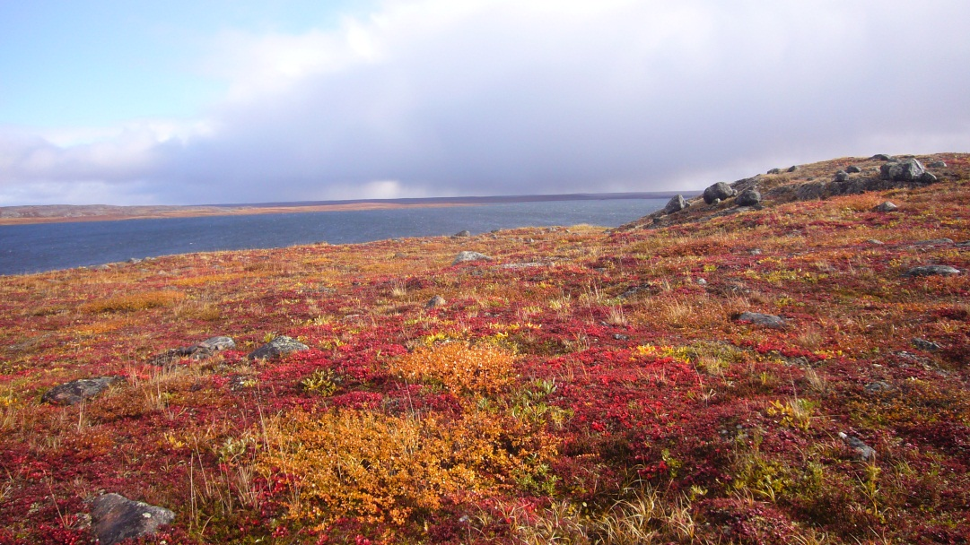
characteristics
Youngest biome: formed 10,000 years ago
Almost all tundras are in the Northern hemisphere
The coldest and driest biome
Two seasons: winter (long) and summer (short)
Permafrost: ground is permanently frozen 25-100 cm (10 in to 3 ft) down
Little biodiversity: 1,700 species of plants, 48 species of land mammals
No trees!
Growing season very short
Permafrost prevents tree roots from growing deep in soil

Slide 7
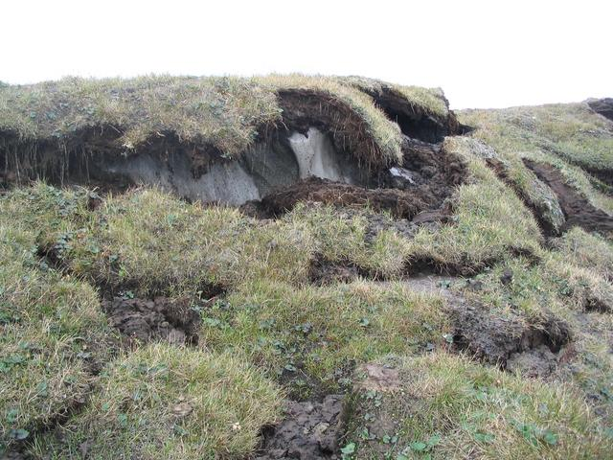
Permafrost
The ground remains permanently frozen all year long. Only the top few feet thaw in summer!

Slide 8
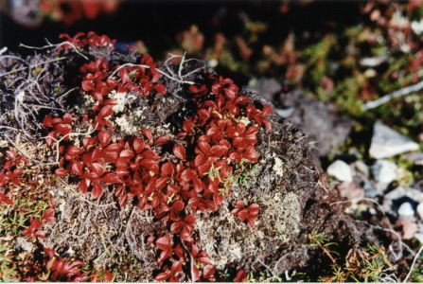
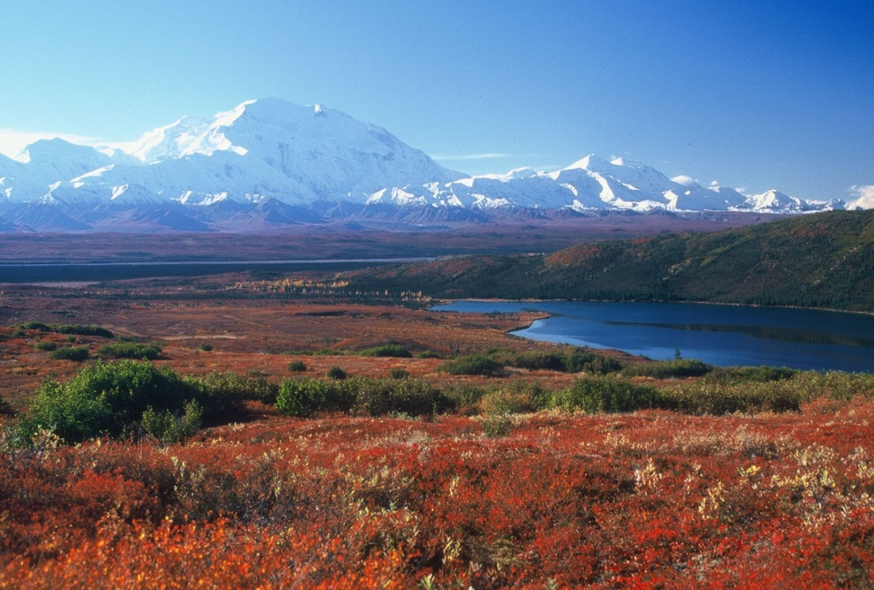
Survival: Plant Adaptations
Low-growing
Red or dark leaves: absorbs heat
Tightly clumped “cushion plants”: protects from cold
NOTE: the Tundra has a
fragile ecosystem
Because the growing season is so short, a plant six inches high could be 30 years old!
If these plants are destroyed, regrowth would require decades

Slide 9
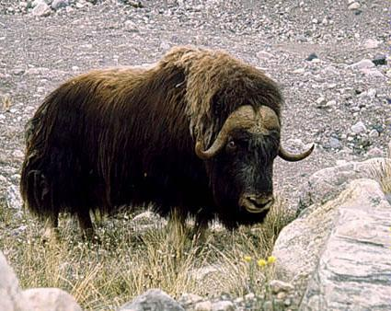
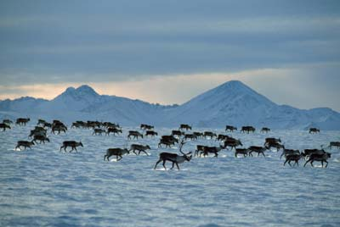
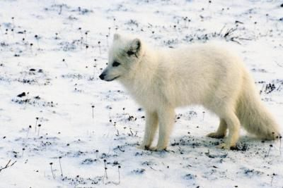
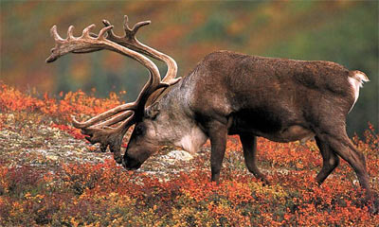
Survival: animal Adaptations
Thick fur, often with undercoat
Camouflage: white in winter & darker in summer
Migration and Hibernation
Musk Ox
Caribou
Arctic Fox

Slide 10
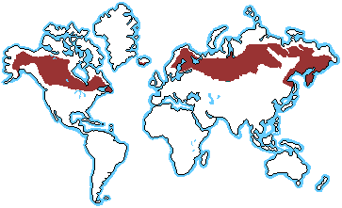
Taiga
Taiga comes from the Russian word for “forest”
Location:

Slide 11
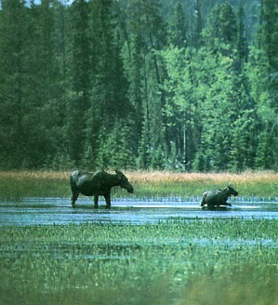
Description
Cold: -40º C – 20º C (-22º F – 68º F)
Moderate precipitation: 30-90 cm (12-33 in) precipitation, which falls mostly as snow
Coniferous forest: evergreen, cone-bearing trees
Moose in the Taiga

Slide 12
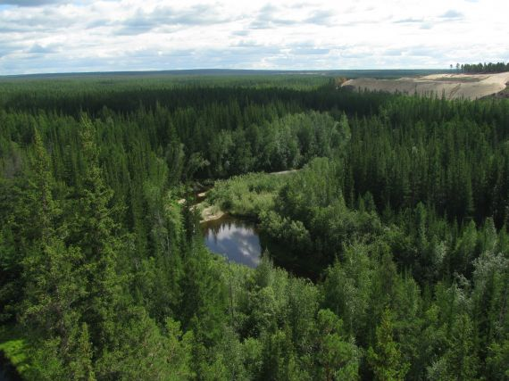
Characteristics
Largest terrestrial biome
Dense tree canopy: little light penentrates
Poor soil; few nutrients, acidic (from decaying needles)
Defined seasons: especially, cold, snowy winters and warm, humid summers
Harsh conditions
Few species

Slide 13
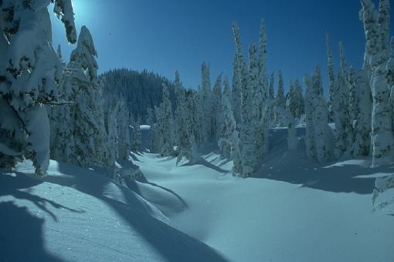
Survival: Plant Adaptations
Thick cuticle: Trees have long, thin waxy needles. Wax protects from cold and dehydration
Evergreen: Trees can begin photosynthesis as soon as weather warms
Dark needles: Dark needles absorb heat
Trees grow close together: this provides protection from cold and wind
Cone shaped: Trees shed snow to prevent branches from breaking

Slide 14
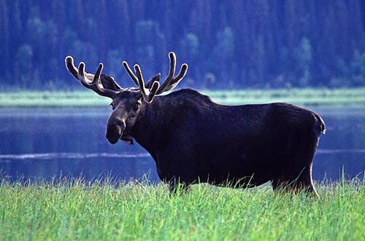
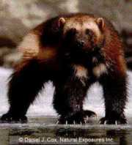
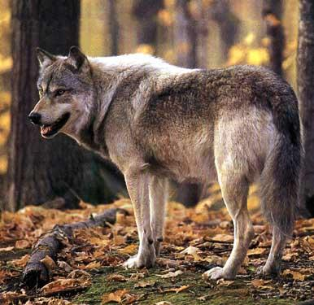
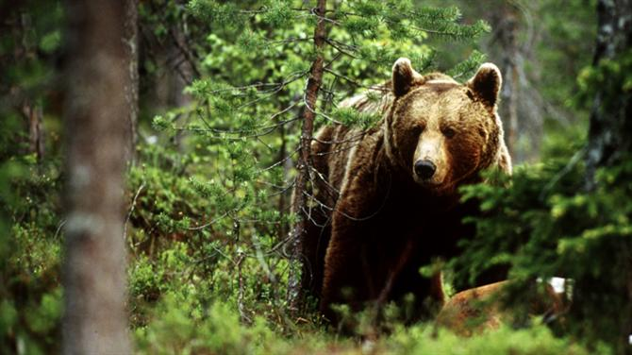
Survival: animal Adaptations
Animals:
Many predators
Migration (birds)
Moose
Wolverine
Wolf
Grizzly (Brown) Bear

