Slide 1
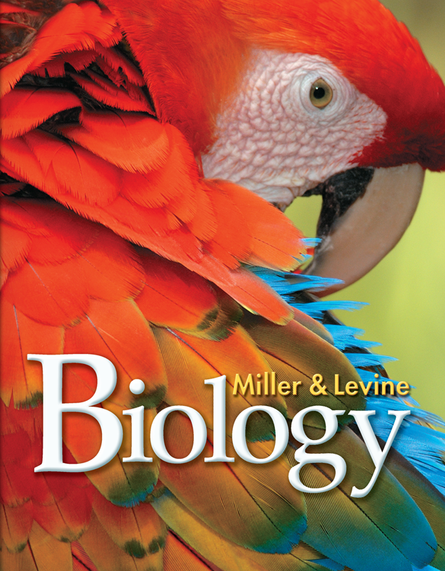
Lesson Overview
Succession

Slide 2
THINK ABOUT IT
WARM-UP:
What would happen to the school grounds if we stopped mowing the grass? What plants and animals would you see…
In 1 year?
In 5 years?
In 20 years?
In 100 years?

Slide 3
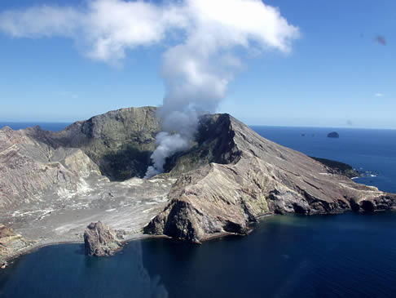
THINK ABOUT IT
In 1883, the volcanic island of Krakatau in the Indian Ocean was blown to pieces by an eruption. The tiny island that remained was completely barren…like this volcanic island today
White Island, New Zealand
http://www.helinz.co.nz/helicopter-flights/volcanic

Slide 4
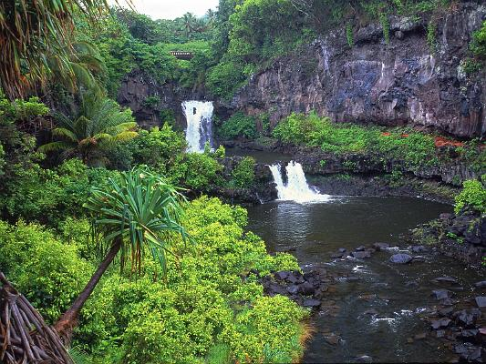
THINK ABOUT IT
Within two years, grasses were growing. Fourteen years later, there were 49 plant species, along with lizards, birds, bats, and insects. By 1929, a forest containing 300 plant species had grown. Today, the island is blanketed by mature rain forest.
How did the island ecosystem recover so quickly?
Oheo, Maui, Hawaii
http://wallpapersforyou.info/Travel/slides/7%20Pools%20of%20Oheo,%20Maui,%20Hawaii.html

Slide 5
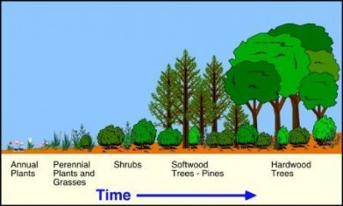
Primary and Secondary Succession
How do communities change over time?
http://www.imamuseum.org/blog/2010/09/29/setting-the-record-straight-the-truth-about-100-acres/

Slide 6
Primary and Secondary Succession
Ecological succession is a series of more-or-less predictable changes that occur in a community over time.
Ecosystems change over time, especially after disturbances, as some species die out and new species move in.
Over the course of succession, the number of different species present typically increases.

Slide 7
Primary Succession
Volcanic explosions can create new land or sterilize existing areas. Cooled lava leaves bare rock.
Retreating glaciers can have the same effect, leaving only exposed bare rock behind them.
Succession that begins in an area with no remnants leftovers) of an older community is called primary succession.

Slide 8
Primary Succession
For example, in Glacier Bay, Alaska, a retreating glacier exposed bare rock.
Over the course of more than 100 years, a series of changes has led to the hemlock and spruce forest currently found in the area
Changes in this community will continue for centuries.

Slide 9
Primary Succession
Primary Succession begins in a place with NO SOIL
Steps:
Bare rock, nothing lives
Lichens: acids break down rocks. Rock particles and the remains of dead lichens mix to start the formation of soil.
Mosses grow. Insects and other tiny organisms live in the area. Their remains add to the soil.
Soil deepens. Ferns, grasses and wildflowers grow. Shrubs and small trees may grow.
After 100’s or 1000’s of years, a mature forest may grow.

Slide 10
Primary Succession
The first species to colonize barren areas are called pioneer species.
One ecological pioneer that grows on bare rock is lichen—a symbiosis between a fungus and an alga. (mutualism)

Slide 11
Primary Succession
Over time, lichens convert, or fix, atmospheric nitrogen into useful forms for other organisms, break down rock, and add organic material to form soil.
Certain grasses, like those that colonized Krakatau early on, are also pioneer species.

Slide 12
Secondary Succession
Sometimes, existing communities are not completely destroyed by disturbances. In these situations, secondary succession occurs.
Secondary succession proceeds faster than primary succession, in part because soil survives the disturbance. As a result, new and surviving vegetation can regrow rapidly.

Slide 13
Secondary Succession
Secondary succession often follows a wildfire, hurricane, or other natural disturbance.
We think of these events as disasters, but many species are adapted to them. Although forest fires kill some trees, for example, other trees are spared, and fire can stimulate their seeds to germinate.
Secondary succession can also follow human activities like logging and farming.

Slide 14
Secondary Succession
Secondary Succession begins where soil is intact.
Steps:
Grasses and other weeds start to grow
New weeds appear. Wind and insects may bring seeds.
Small conifers grow. A forest may form
Deciduous trees may replace conifers.

Slide 15
Secondary Succession
This series shows secondary succession taking place in abandoned fields of the Carolinas’ Piedmont.
Over the last century, these fields have passed through several stages and matured into oak forests. Changes will continue for years to come.

Slide 16
Why Succession Occurs
Every organism changes the environment it lives in.
One model of succession suggests that as one species alters its environment, other species find it easier to compete for resources and survive.
For example, as lichens add organic matter and form soil, mosses and other plants can colonize and grow.
As organic matter continues to accumulate, other species move in and change the environment further.
Over time, more and more species can find suitable niches and survive.

Slide 17
Climax Communities
Do ecosystems return to “normal” following a disturbance?
Secondary succession in healthy ecosystems following natural disturbances often reproduces the original climax community.
Ecosystems may or may not recover from extensive human-caused disturbances.

Slide 18
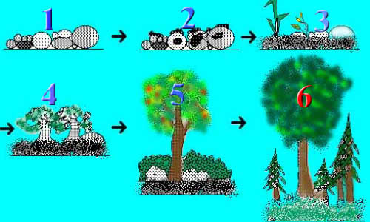
Climax Communities
Climax community is the final community after succession.
Climax species: well-adapted, slow-growing species in an ecosystem
Is a mature climax community always as forest?
http://csetprep.org/science/system-11.htm

Slide 19
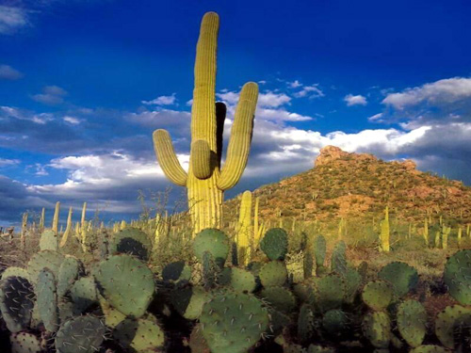
Climax Communities
No!
http://home.comcast.net/~DiazStudents/ahistory_units_1.htm

Slide 20
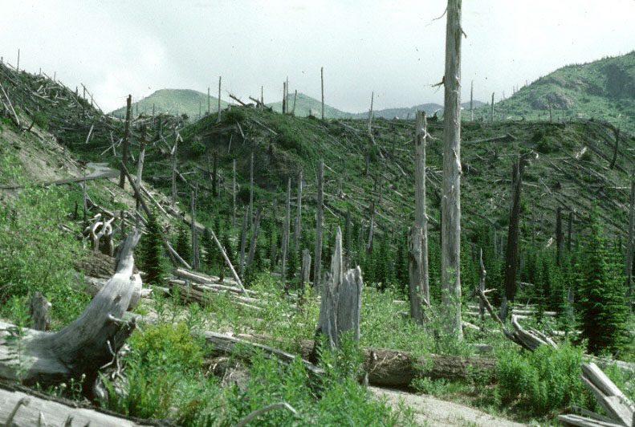
Succession After Natural Disturbances
Secondary succession in healthy ecosystems following natural disturbances often reproduces the original climax community.
Healthy coral reefs and tropical rain forests often recover from storms, and healthy temperate forests and grasslands recover from wildfires.
http://www.youtube.com/watch?v=V49IovRSJDs
Mt. St . Helens, Washington State
http://www.wsu.edu/~wsherb/edpages/raingrass/succession.html

Slide 21
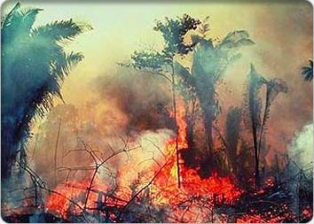
Succession After Human-Caused Disturbances
Ecosystems may or may not recover from extensive human-caused disturbances.
Clearing and farming of tropical rain forests, for example, can change the microclimate and soil enough to prevent regrowth of the original community. (slash and burn agriculture)
http://www.biology.duke.edu/bio217/2005/tnb/anthropogenic.html

