Slide 1
Freshwater Biome
Moving Water Ecosystem
Deeper Water Ecosystem
Shallow Water Ecosystem

Slide 2
What is an Ecosystem?
A community of living organisms and its abiotic environment.
Two factors in Ecosystems:
Biotic Factors: Living organisms that live together and interact with one another
Abiotic Factors: NON living factors (water, soil, light, and temperature).

Slide 3
1. Moving Water Ecosystem Streams and Rivers

Slide 4
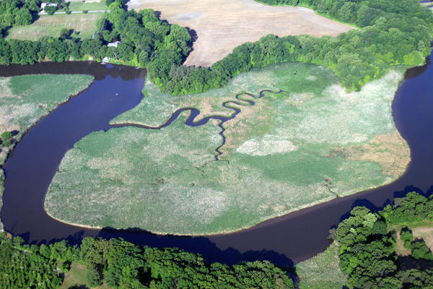
Streams and Rivers
Water can come from melting ice or snow
Water can come from an underground spring
Tributary: stream that joins a larger stream
River: very strong, wide stream

Slide 5
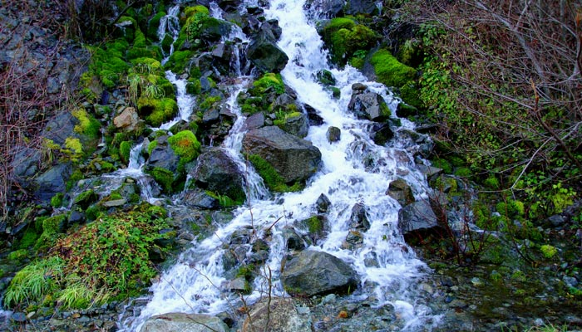
Streams and Rivers
Abiotic factor: how quickly the water moves.
In fast moving water—adaptations needed to keep items from being washed away

Slide 6
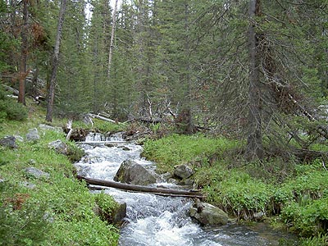
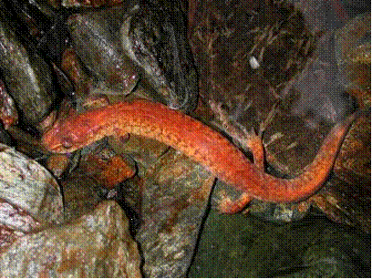
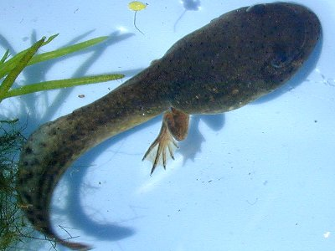
Life in Rivers and Streams
Plants at edges
Fish
Clams and snails in mud
Algae attached to rocks
Tadpoles have suction discs

Slide 7
2. Deeper Water Ecosystem: Ponds and Lakes

Slide 8
Ponds and Lakes
Three Zones
Littoral zone: close to edge, lots of sunlight
Open water zone: goes as deep as sunlight can reach
Deep-water zone: no sunlight; many decomposers feed on dead organisms that sink from above

Slide 9
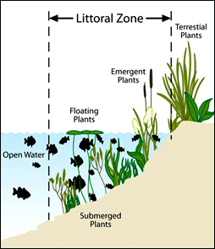
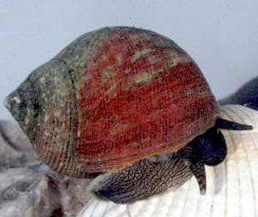
Littoral Zone
algae
Plants: cattails and rushes, water lilies
Animals: snails, insects, clams, worms, frogs, salamanders, turtles, fish, snakes

Slide 10
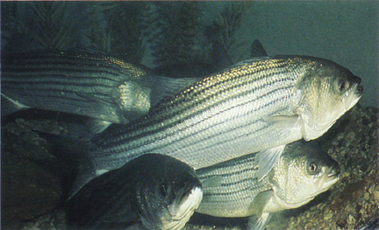
Open Water Zone
Plankton, including algae
Fish: bass, lake trout, other fishes

Slide 11
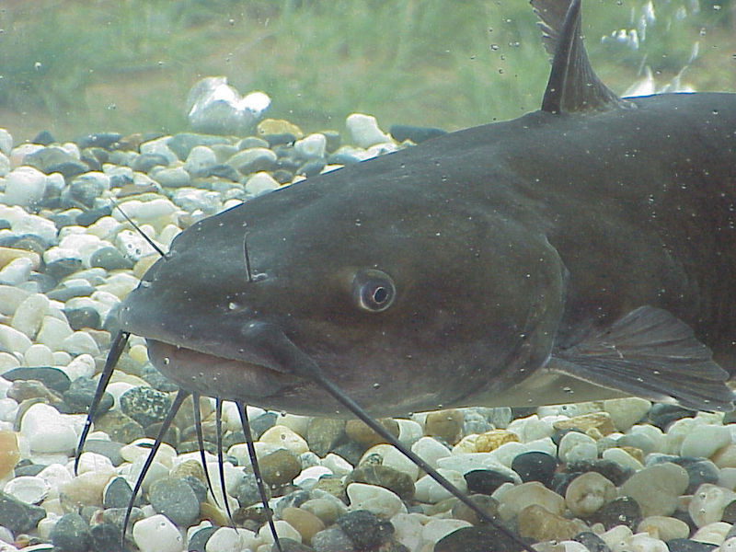
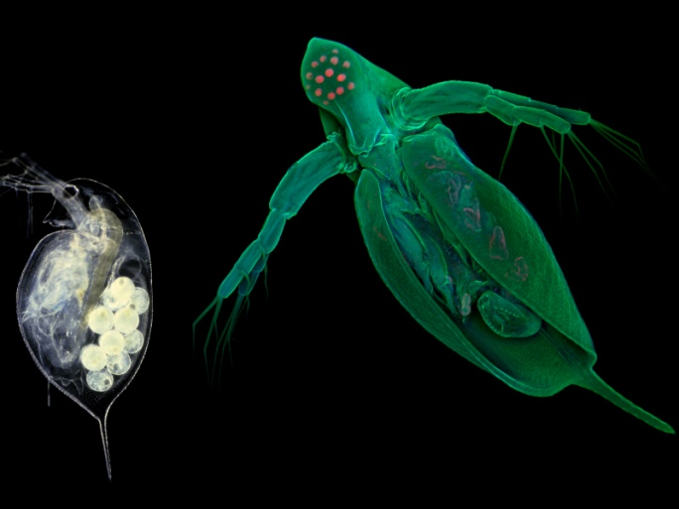
Deep Water Zone
Catfish, carp, worms, crustaceans, fungi, bacteria.

Slide 12
3. Shallow Water Ecosystem Wetlands: Marshes and Swamps

Slide 13
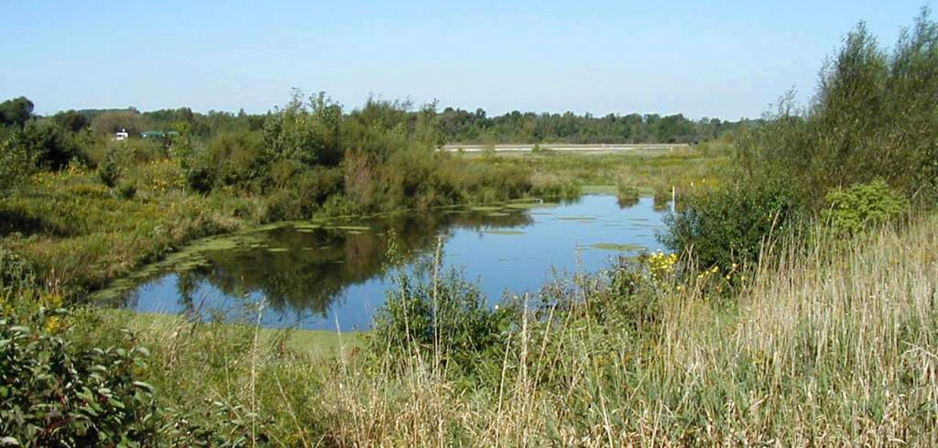
Wetland
Area underwater or whose soil contains lots of moisture
Important in flood control: soaks up lots of water
Helps replenish underground water supplies

Slide 14
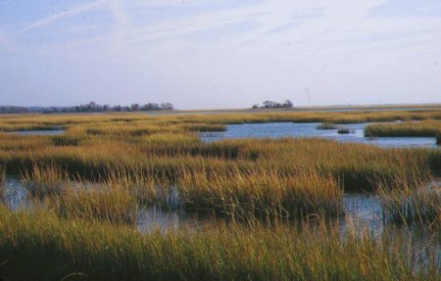
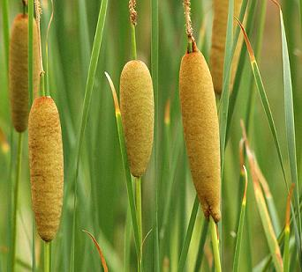
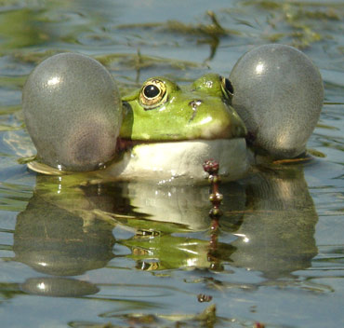
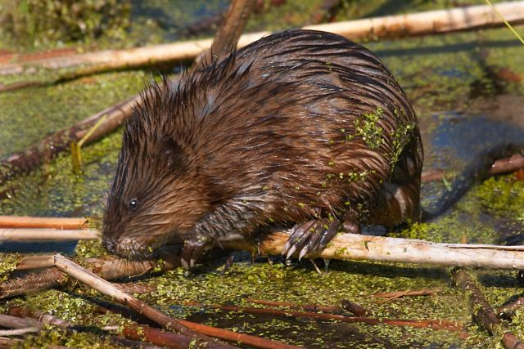
Marshes
Marsh: treeless wetland; found in shallow areas along lakes, ponds, rivers, and streams
Marsh life:
Plants: grasses, reeds, bulrushes, wild rice
Animals: muskrats, turtles, frogs, birds

Slide 15
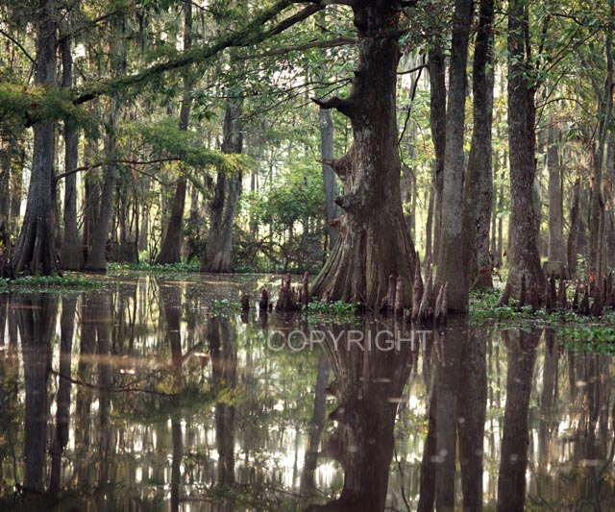
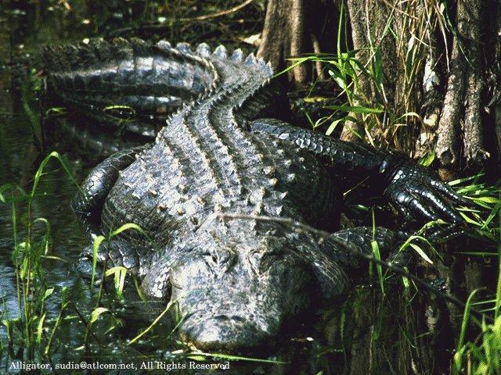
Swamps
Swamp: wetland with trees and vines; low areas near slow rivers; flooded part of year
Swamp Life:
Plants: willows, bald cypresses, oaks, vines, poison ivy, orchids, water lilies
Animals: fishes, snakes, birds, alligators, turtles

