Slide 1
Desert or Rainforest??

Slide 2
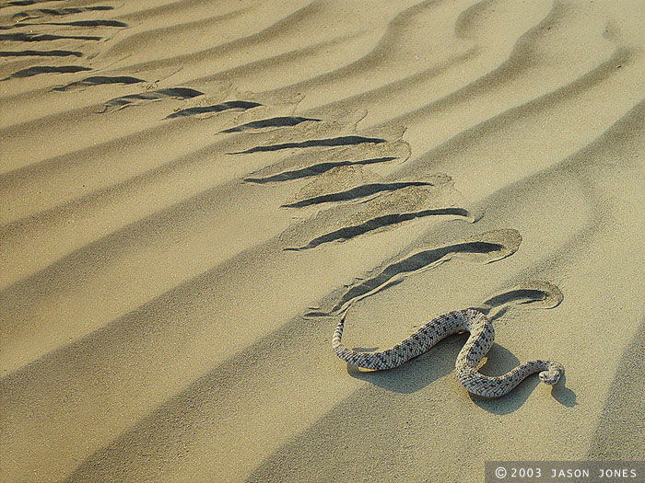
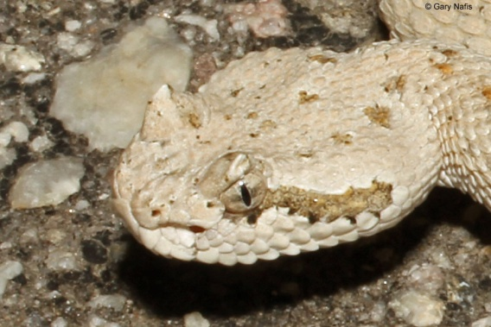
Sidewinder
http://www.californiaherps.com/snakes/pages/c.c.laterorepens.html

Slide 3
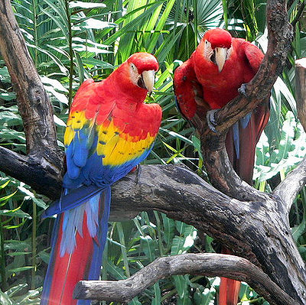
Macaw
http://thepetwiki.com/wiki/Macaw

Slide 4
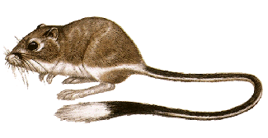
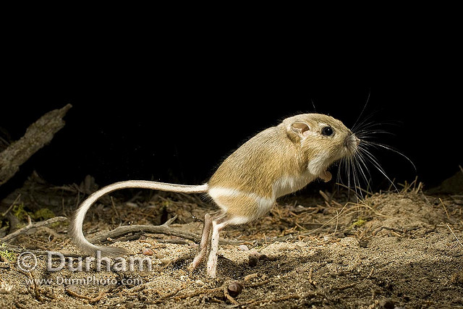
Kangaroo Rat
http://animals.howstuffworks.com/mammals/kangaroo-rat-info.htm
http://www.flickr.com/photos/oregonwild/2779737594/

Slide 5
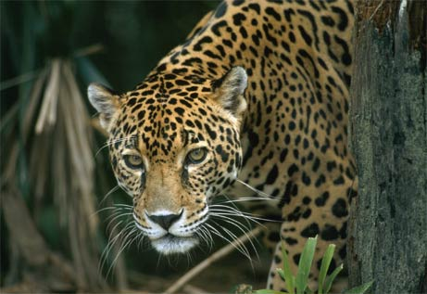
Jaguar
http://news.nationalgeographic.com/news/2003/11/photogalleries/jaguar/

Slide 6
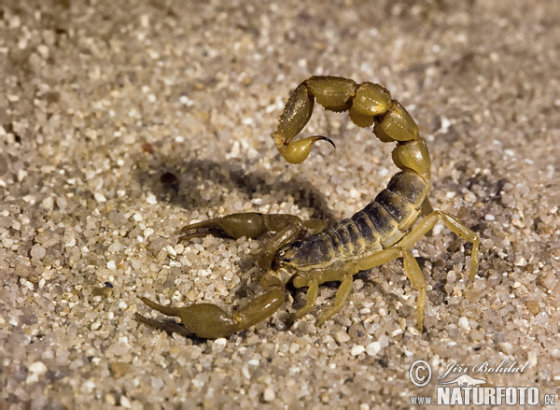
Scorpion
http://www.naturephoto-cz.com/scorpion-photo-755.html

Slide 7
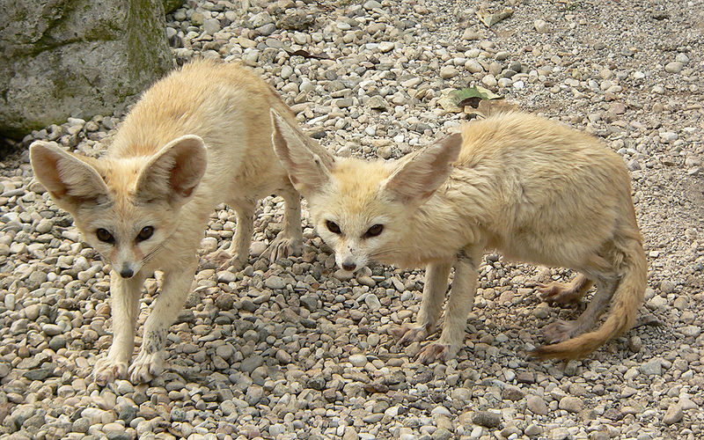
Fennec Fox
http://www.wild-facts.com/tag/fennec-fox/

Slide 8
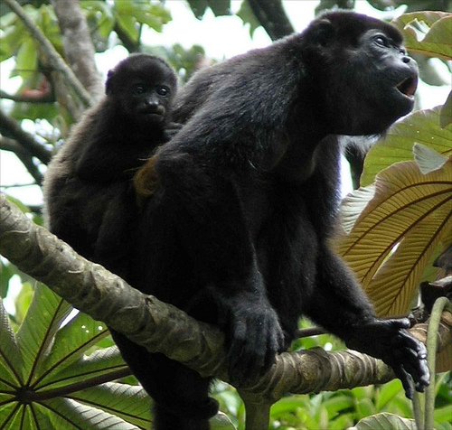
Howler monkey
http://www.flickriver.com/photos/lonqueta/4103646456/

Slide 9
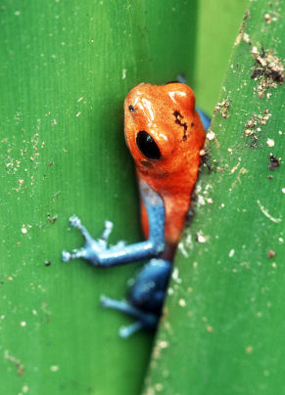
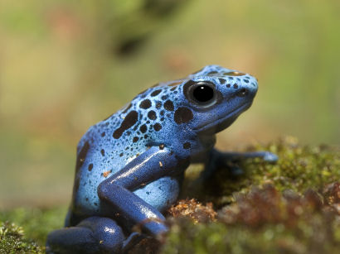
Poison Arrow Dart Frog
http://www.tropical-rainforest-animals.com/Strawberry-Poison-Dart-Frog.html

Slide 10
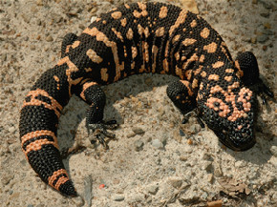
Gila monster
http://knoxville-zoo.org/case-studies/115

Slide 11
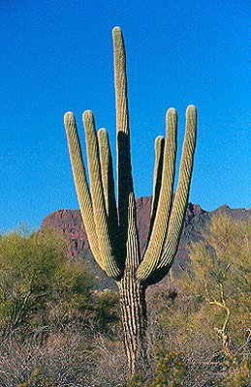
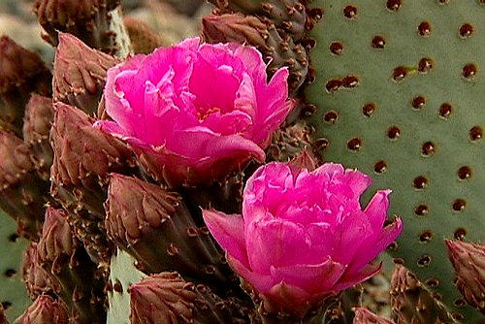
Saguaro
http://www.vividlight.com/articles/2905.htm

Slide 12
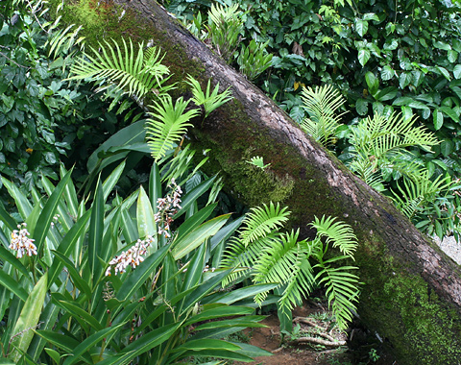
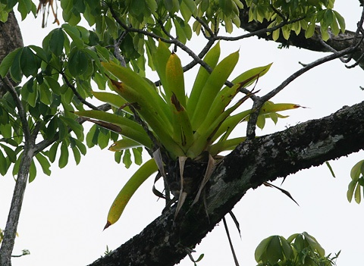
Epiphyte epi = on phyte = plant
http://fireflyforest.net/firefly/2006/07/21/epiphytes/

Slide 13
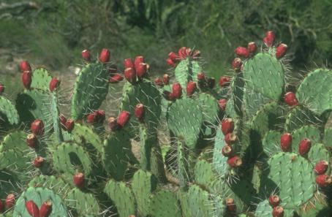
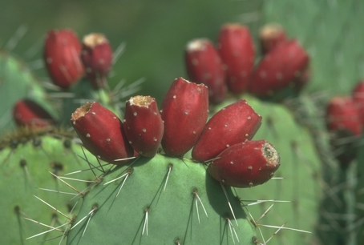
Prickly Pear cactus
http://www.discoverseaz.com/Wildlife/PricklyPear.html

Slide 14
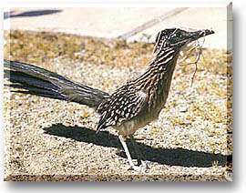
Roadrunner

Slide 15
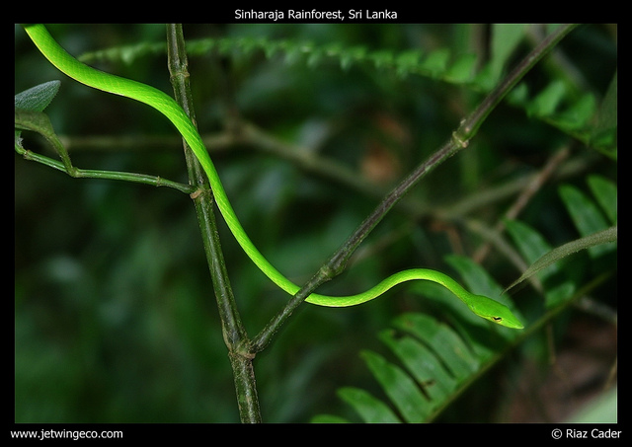
Vine snake
http://www.flickr.com/photos/riazcader/4611923965/

Slide 16
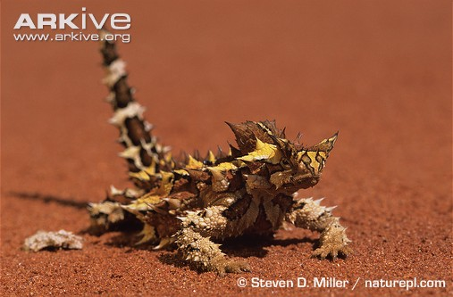
Thorny Devil
http://www.arkive.org/thorny-devil/moloch-horridus/

Slide 17
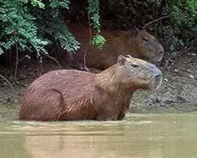
Capybara
http://www.amazon-tours.com/tourism-bolivia/tours.html

Slide 18
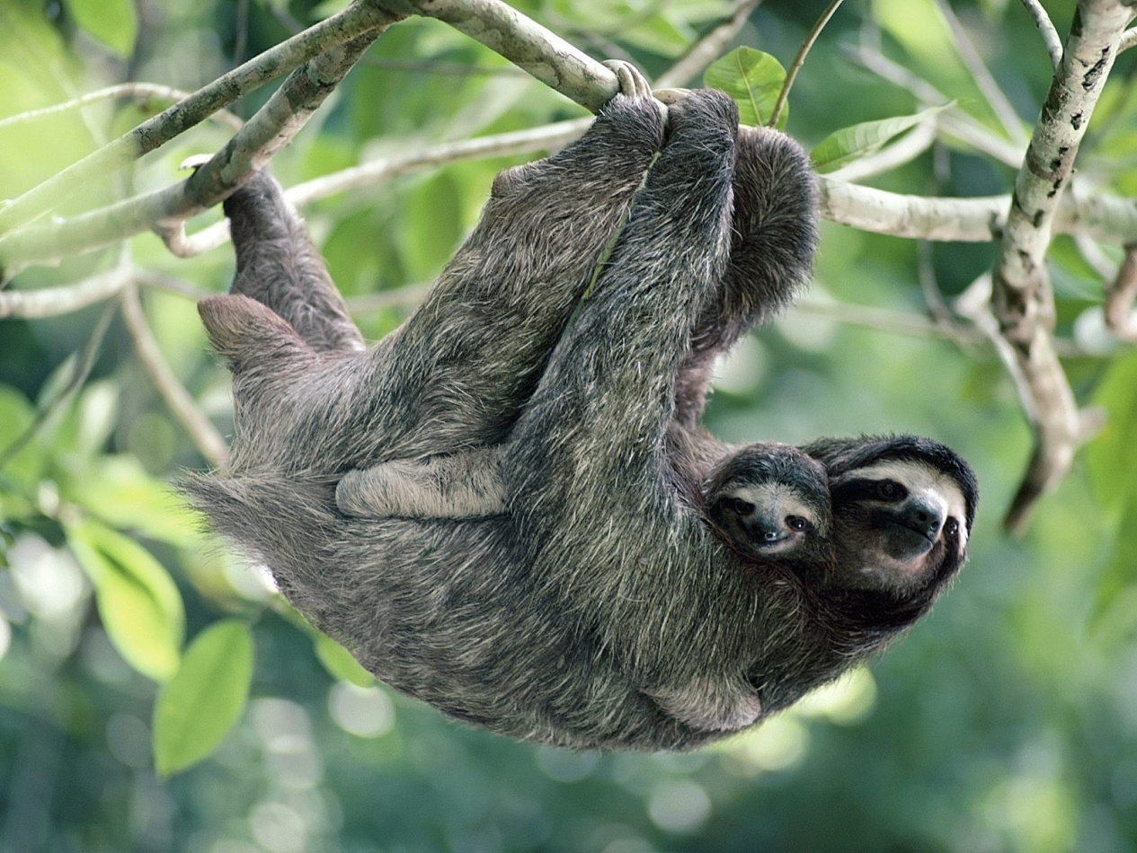
Three-toed sloth
http://my.opera.com/licona/albums/showpic.dml?album=556616&picture=7650926

Slide 19
Key
1. Sidewinder DE
2. Macaw RF
3. Kangaroo Rat DE
4. Jaguar RF
5. Scorpion DE
6. Fennec Fox DE
7. Howler Monkey RF
8. Poison Arrow Frog RF
9. Gila monster DE
10. Saguaro DE
11. Epiphyte RF
12. Prickly Pear DE
13. Roadrunner DE
14. Vine Snake DE
15. Thorny Devil DE
16. Capybara RF
17. Three-toed sloth RF

