Slide 1
Grassland, Savanna, or Deciduous forest????

Slide 2
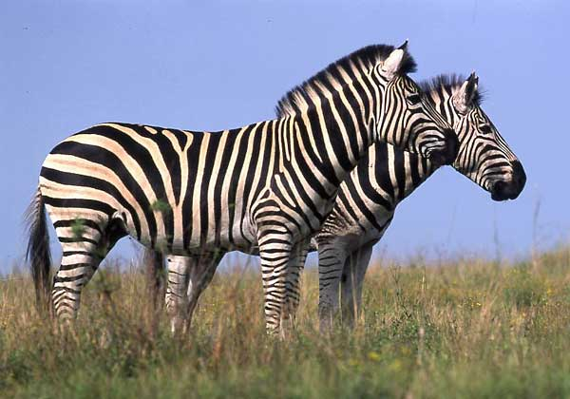
Zebra

Slide 3
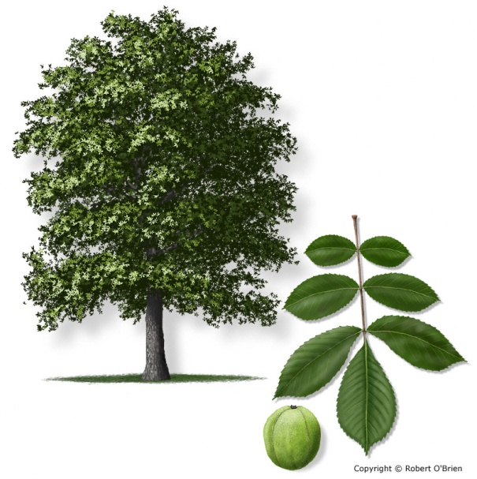
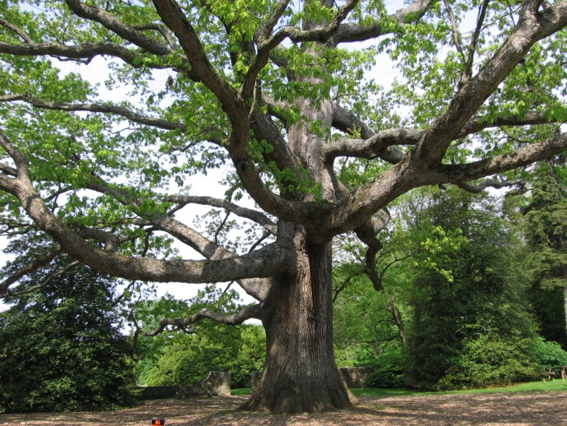
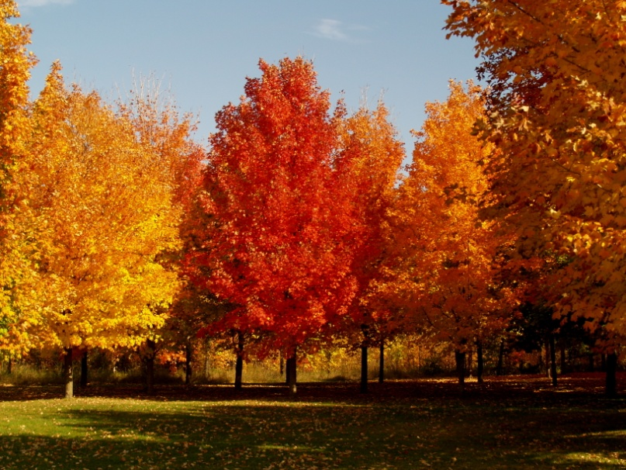
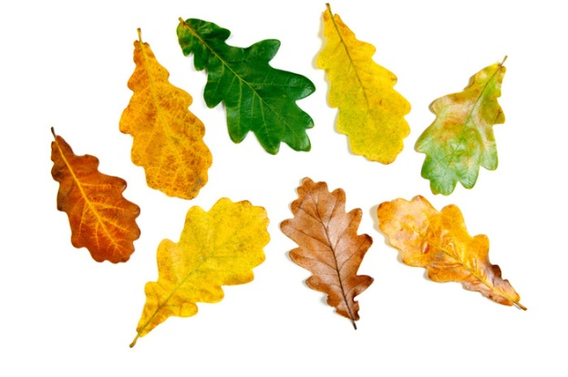
Oaks, Maples, Hickory

Slide 4
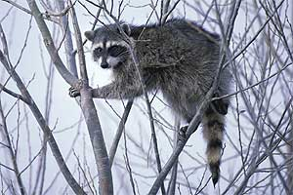
Raccoon

Slide 5
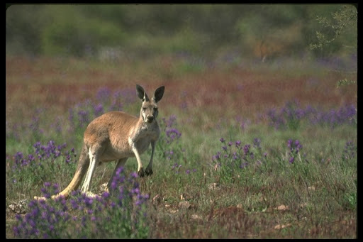
Kangaroo

Slide 6
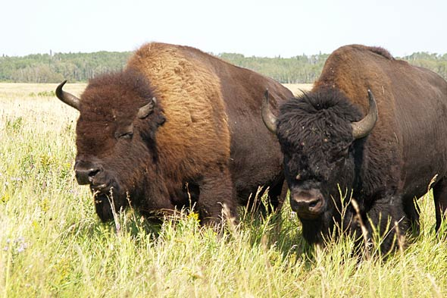
Buffalo/ Bison

Slide 7
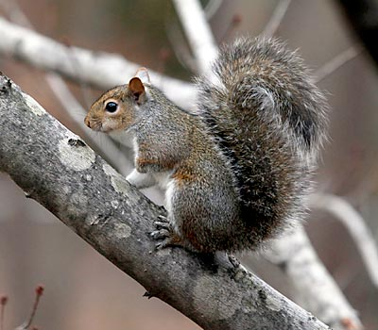
Gray Squirrel
http://www.agfc.com/species/Pages/SpeciesWildlifeDetails2.aspx?Title=Gray%20Squirrel

Slide 8
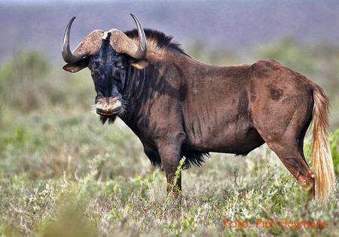
Wildebeest
http://www.africancraftsmarket.com/Black-Wildebeest-horns-skull.htm

Slide 9
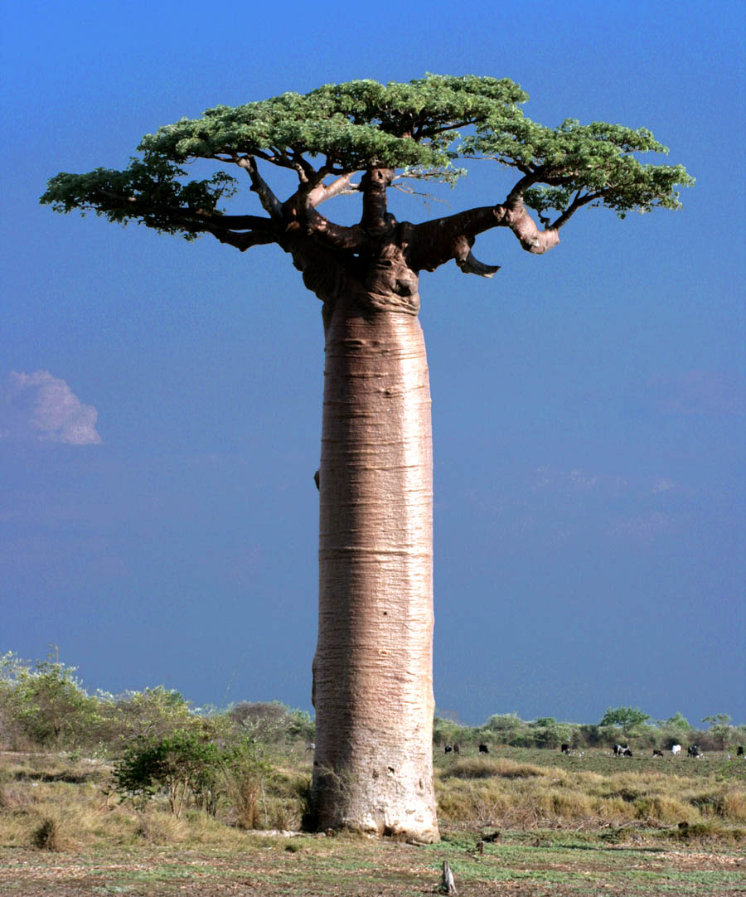
Baobab

Slide 10
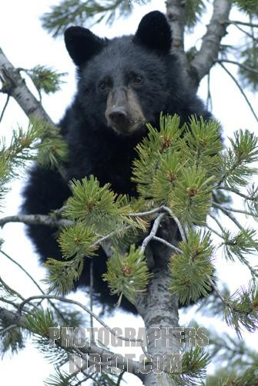
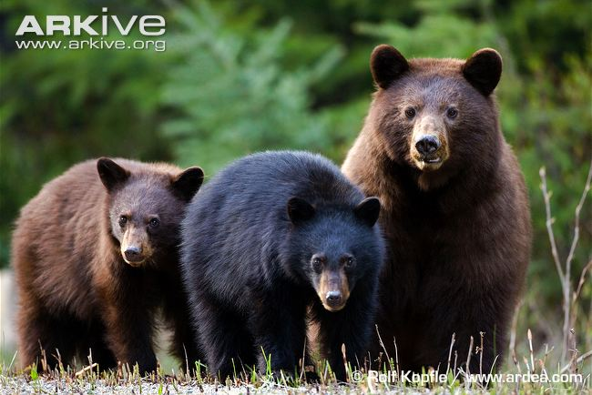
Black Bear
http://www.arkive.org/american-black-bear/ursus-americanus/image-G57645.html

Slide 11
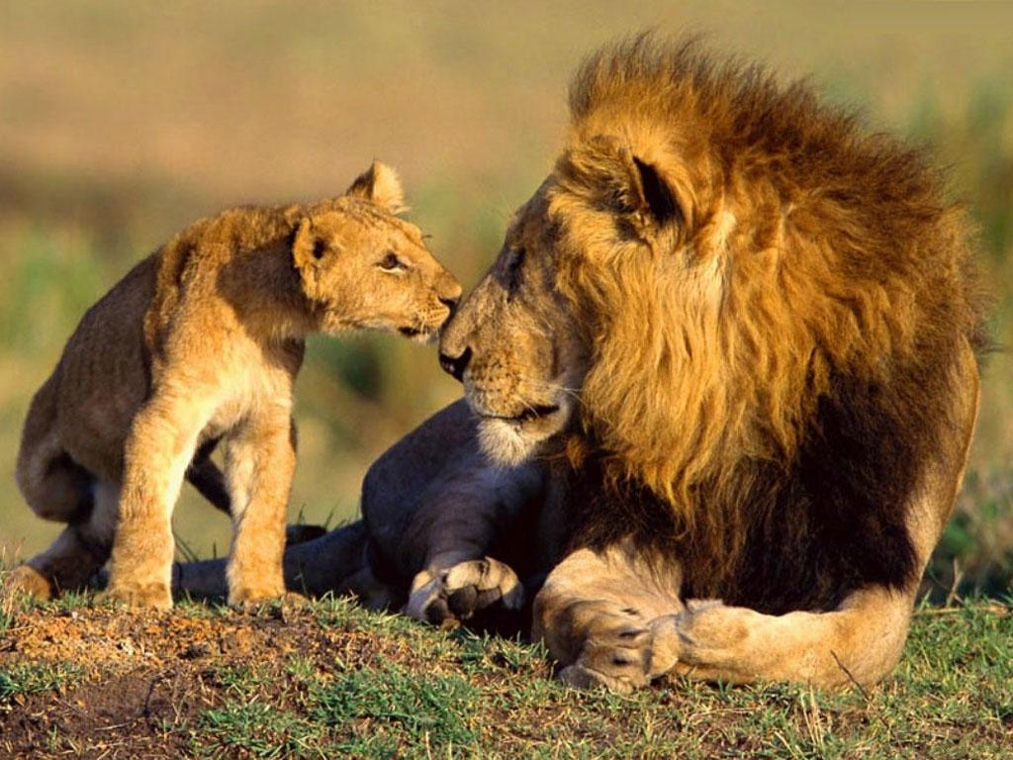
Lions
http://www.deshow.net/animal/wild-lions-645.html

Slide 12
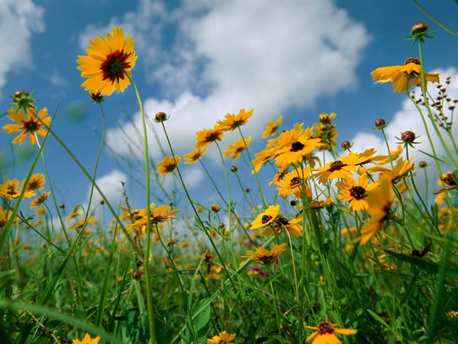
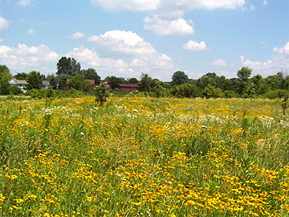
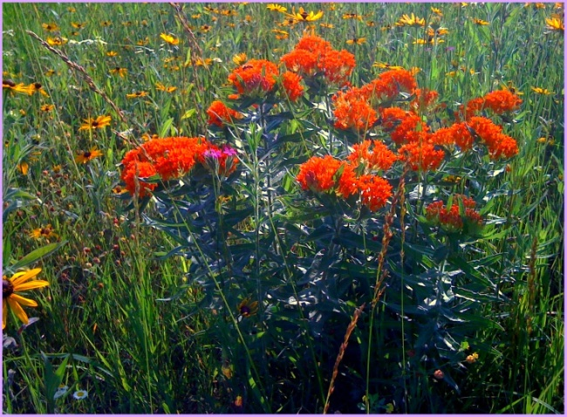
Prairie Wildflowers
http://meredithlindley.blogspot.com/2010_09_01_archive.html
http://www.ci.muskego.wi.us/ConservationServices/Conservation/Prairies/tabid/668/Default.aspx
http://chez-frontporch.blogspot.com/2010/06/kansas-tallgrass-prairie-wildflowers.html

Slide 13
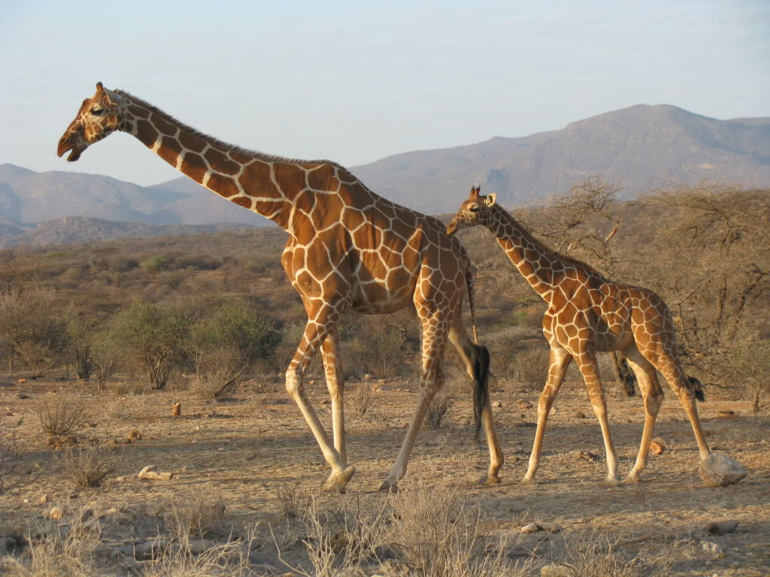
Giraffes
http://www.animalspot.net/gallery/giraffe-pictures

Slide 14
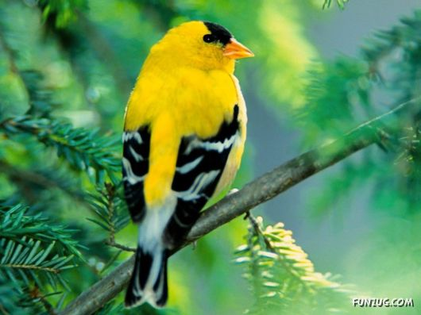
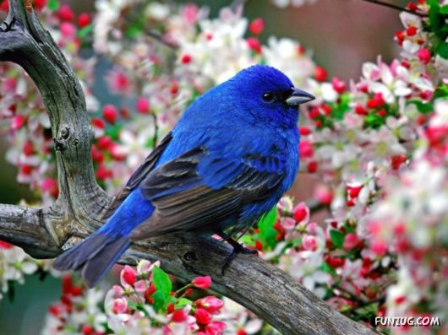
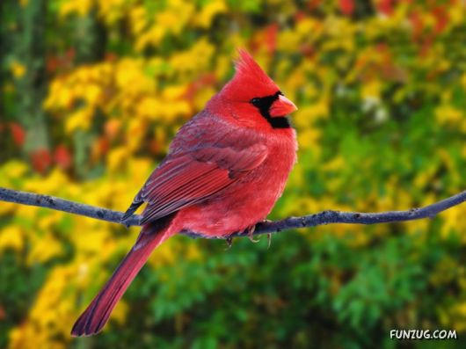
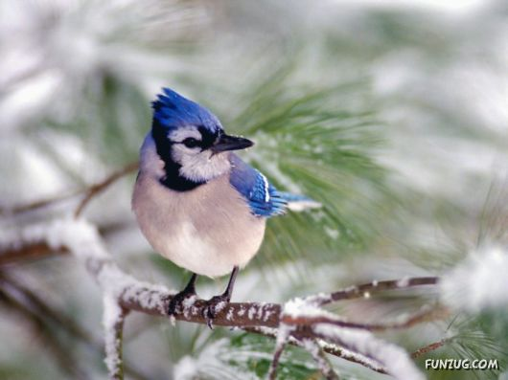
Song Birds
http://www.funzug.com/index.php/wildlife/beautiful-wild-song-birds.html

Slide 15
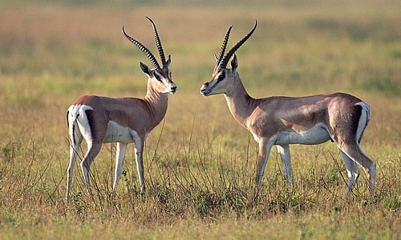
Gazelle
http://www.animalcorner.co.uk/wildlife/gazelle.html

Slide 16
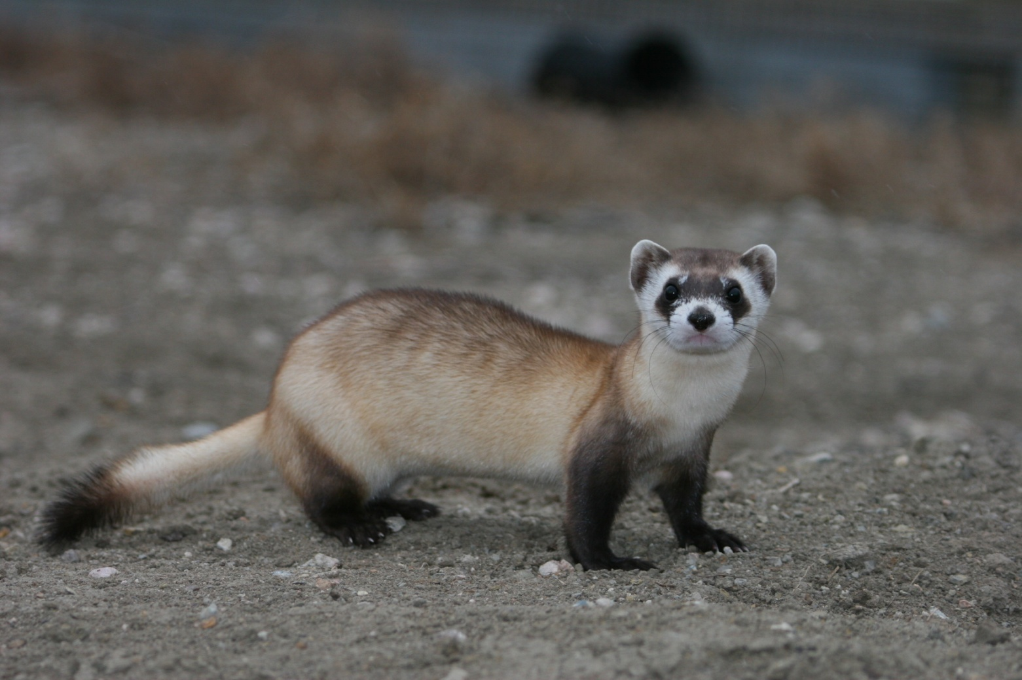
Black footed ferret
http://www.biohabitats.com/ndg_newsite/newsletter/2010summer/interview1.php

Slide 17
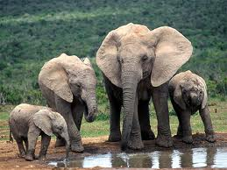
Elephant
http://www.worldwildlife.org/species/finder/elephants/elephants.html

Slide 18
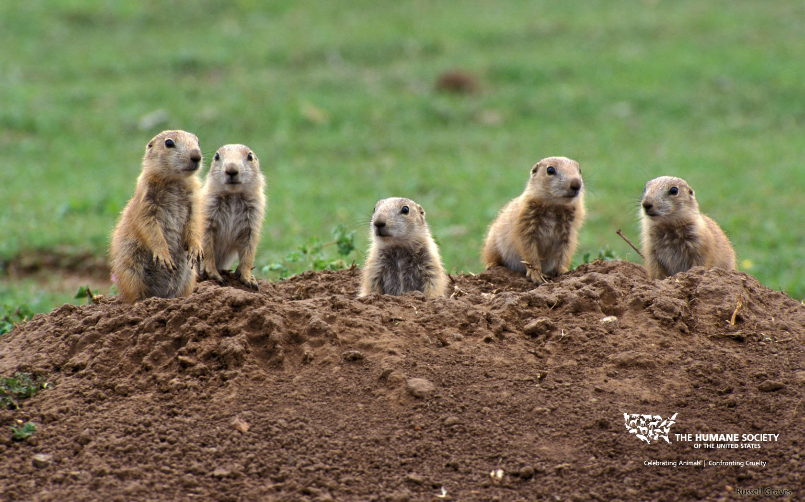
Prairie Dog
http://www.humanesociety.org/news/news/2010/08/prairie_dog_wallpaper.html

Slide 19
Key
Place a DF by the plants and animals from the Deciduous Forest,
a SA by the plants and animals from the Savanna,
and a GR from plants and animals from Grasslands.
1. Zebra SA
2. Oaks, hickory, maple DF
3. Raccoon DF
4. Kangaroo GR
5. Buffalo/Bison GR
6. Gray squirrel DF
7. Wildebeest SA
8. Baobab SA
9. Black bear DF
10. Lions SA
11. Prairie wildflowers GR
12. Giraffes SA
13. Song Birds DF
14. Gazelle SA
15. Black-footed ferret GR
16. Elephants SA
17. Prairie dogs GR

