Slide 1
Tundra or Taiga?
For each of the following pictures, decide if the scene is from the Tundra or Taiga

Slide 2
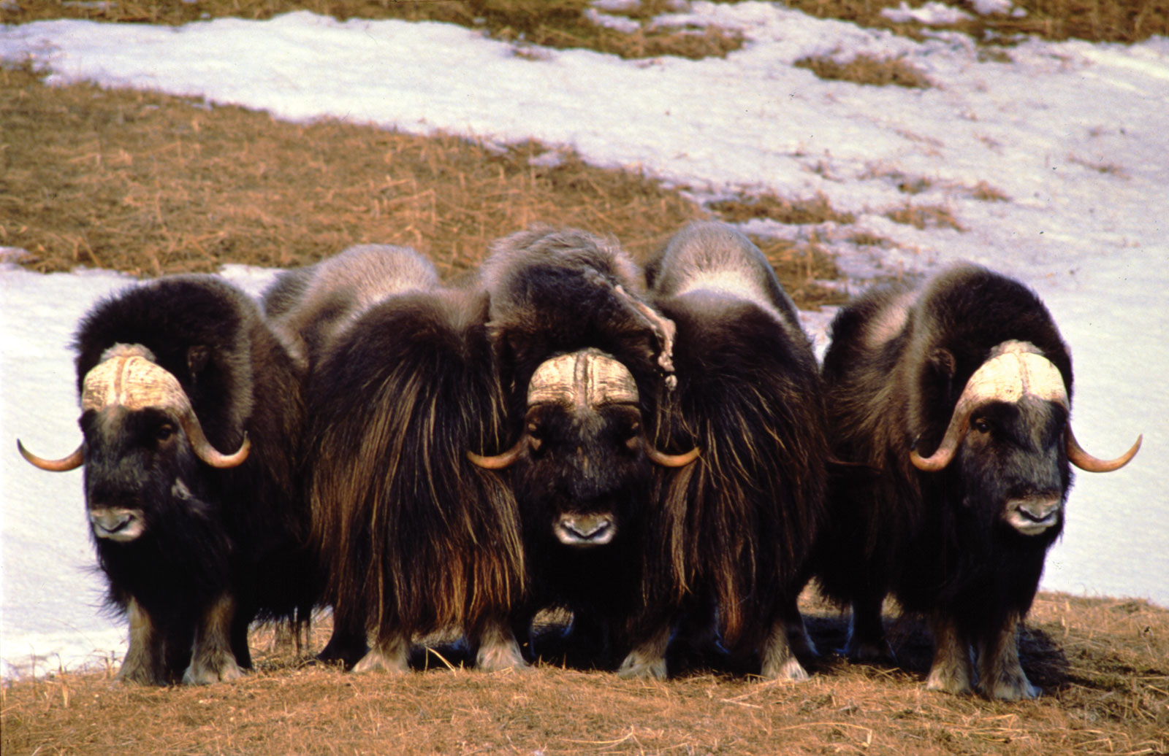
Musk ox
http://tundra-animals-plants.blogspot.com/2011/05/tundra-animals-muskox.html

Slide 3
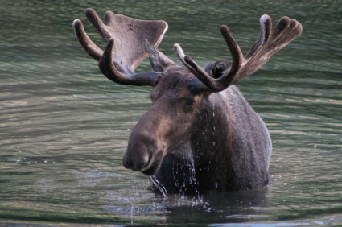
Moose
http://mswilliamsewa.pbworks.com/w/page/31420997/Hatchet

Slide 4
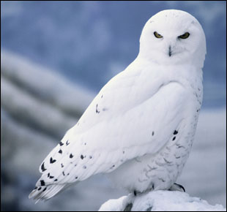
Snowy owl
http://oliviadomhs.edublogs.org/2010/05/10/tundra-animals/

Slide 5
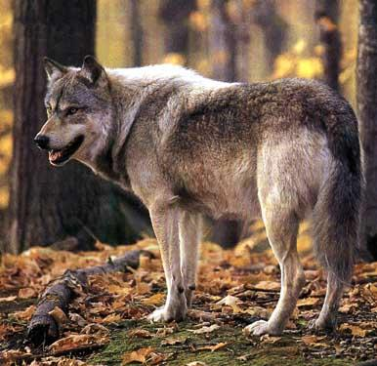
Wolves
http://www.ticrk.ru/en/gallery.php?docId=8089

Slide 6
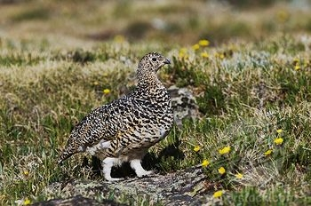
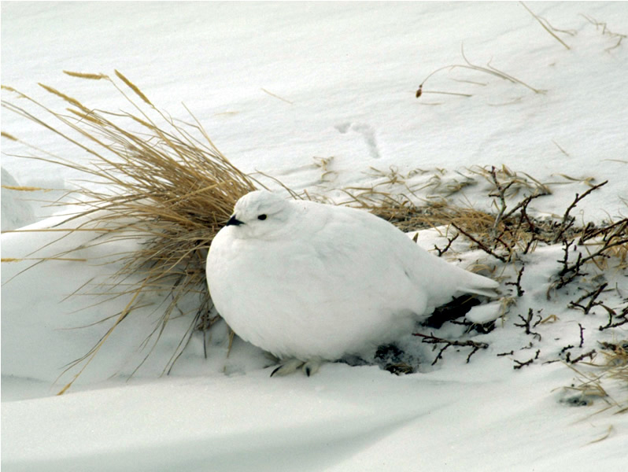
Ptarmigan
http://www.superstock.com/stock-photos-images/1848-144256
http://www.nps.gov/romo/ptarmigan_camouflage.htm

Slide 7
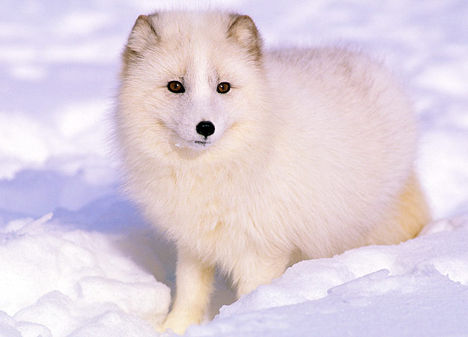
Arctic fox
http://animal.discovery.com/tv/a-list/creature-countdowns/animal-transformers/transformers-05.html

Slide 8
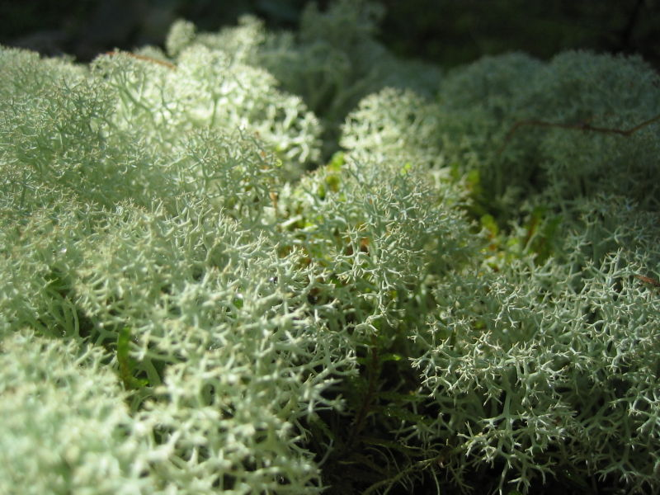
Lichens
http://www.arthurmag.com/2010/01/03/plants-of-the-tundra/

Slide 9
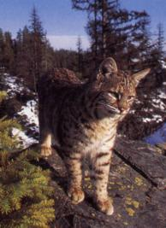
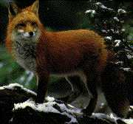
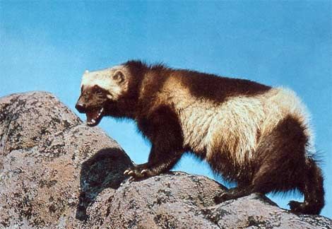
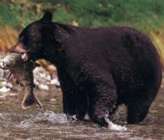
Fox, Wolverine, Lynx, Bear
http://6majorbioms.blogspot.com/2009/05/taiga-animals-and-4-organism-food-chain.html

Slide 10
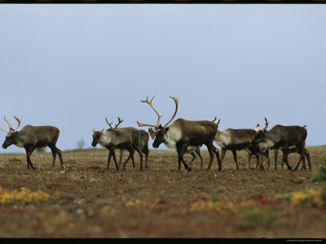
Caribou (Reindeer)
http://www.art.com/products/p14272932-sa-i2893746/a-group-of-caribou-in-a-tundra-landscape.htm

Slide 11
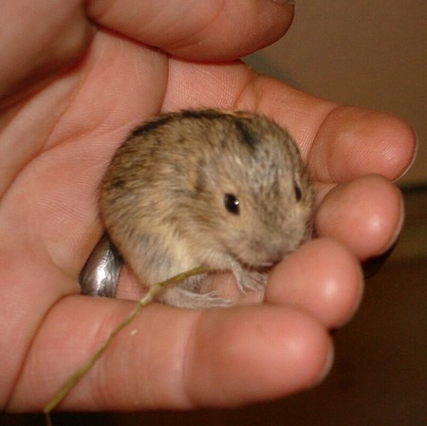
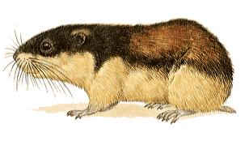
Lemmings
http://web.bryant.edu/~langlois/ecology/arcticanimals.html
http://ydtalk.com/jdispatch/2012/03/05/little-white-fox-helps-himself/

Slide 12
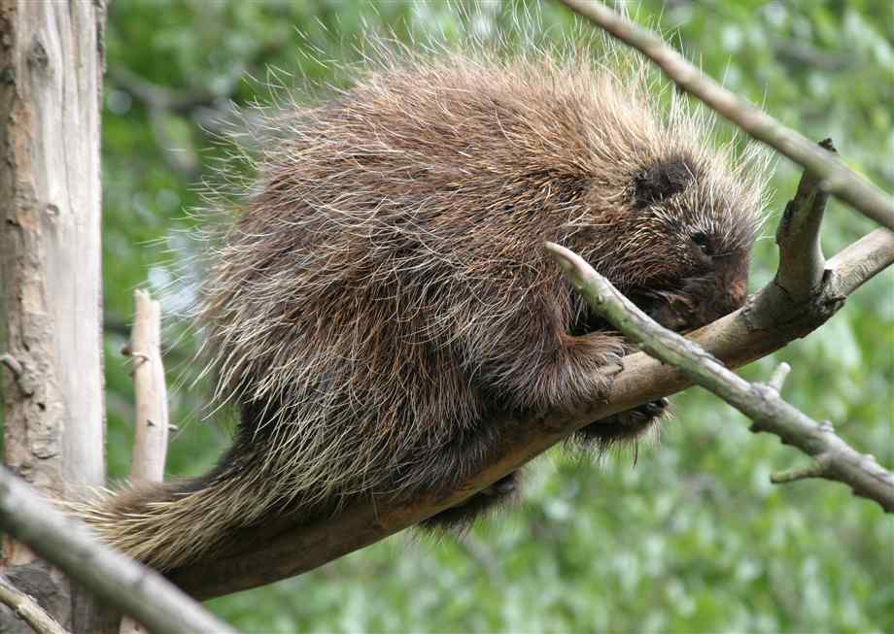
Porcupine
http://www.northrup.org/photos/porcupine/

Slide 13
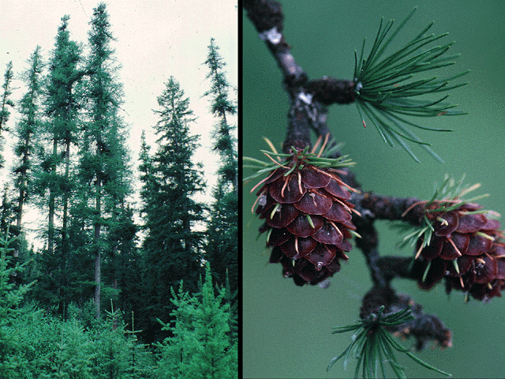
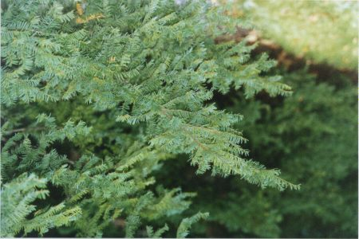
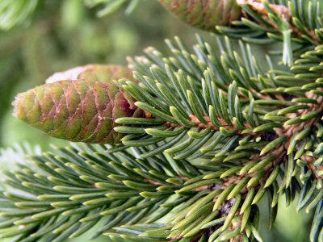
Conifers
http://www.ust.hk/~webpepa/pepa/lecture_notes/ecosystem/index.htm
http://danforthbiomeproject.pbworks.com/w/page/11596919/Taiga%20Plants%20and%20Animals

Slide 14
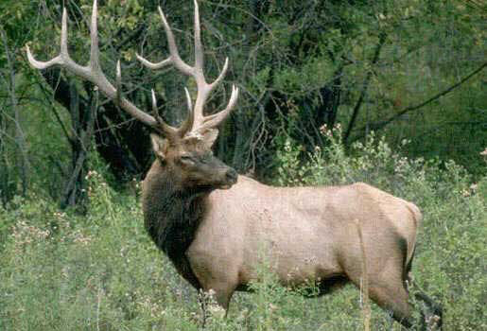
Elk
http://co.laplata.co.us/faq/living_deer_and_elk

Slide 15
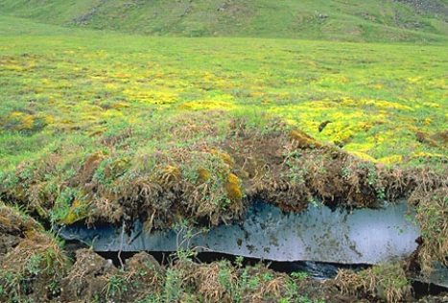
Permafrost
http://bleucheesebio.blogspot.com/2010/12/permafrost-top-layer-of-soil-in-tundra.html

Slide 16
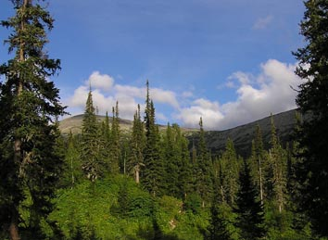
Evergreens
http://ohesvictory-science.wikispaces.com/Taiga

Slide 17
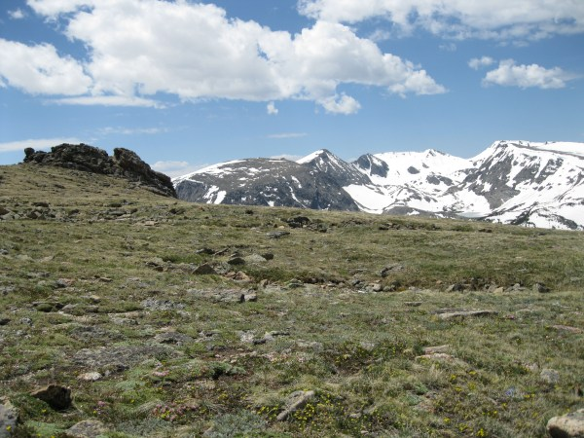
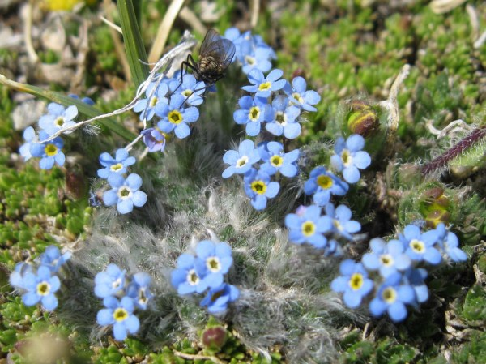
Mosses, willows, small shrubs
http://rebeccainthewoods.wordpress.com/2011/07/19/wildflowers-of-the-rockies-part-2/

Slide 18
KEY
1. Musk ox __TU__
2. Moose __TA__
3. Snowy Owl __TU__
4. Wolves __TA__
5. Ptarmigan __TU__
6. Arctic Fox __TU__
7. Lichens __TU__
8. Wolverine, Lynx __TA__
9. Caribou __TU__
10. Lemmings __TU__
11. Porcupine __TA__
12. Conifers __TA__
13. Elk __TA__
14. Permafrost __TU__
15. Evergreens __TA__
16. Mosses, Willow,
Small Shrubs __TU__

