Slide 1
Terrestrial Biomes.2 Features and Creatures
Grasslands
Deciduous Forests

Slide 2
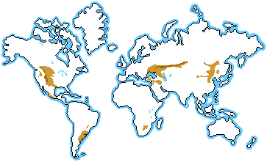
Grasslands: Location
Note: grasslands are often found on the interior of continents!

Slide 3
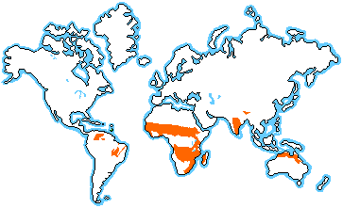
Savanna: Tropical Grassland

Slide 4
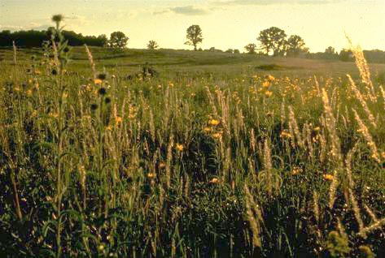
Description
Climate varies by latitude: -20º C – 30º C (-4º F – 86º F)
Moderate precipitation: 50-90 cm (20-35 in) precipitation
Grasses: open and continuous, usually fairly flat areas of grass; a few trees are scattered through the grassland

Slide 5
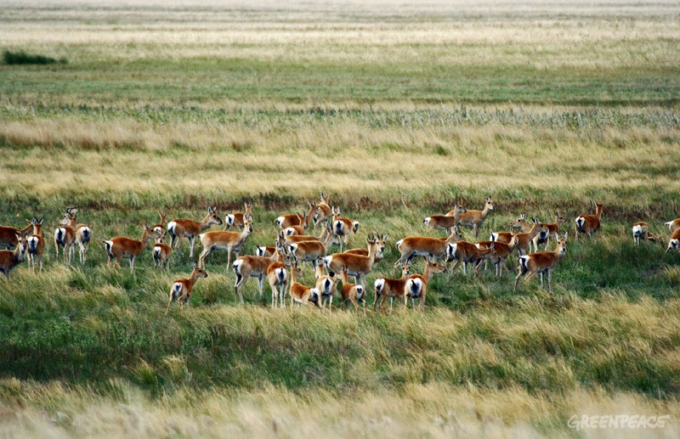
Characteristics
Biome found on all continents, except Antarctica
usually found in the interior of continents at middle latitudes
Many Names: Prairies of the Great Plains of North America; pampas of South America; veldt of South Africa; steppes of Russia; savanna of Africa
Steppes of Russia

Slide 6
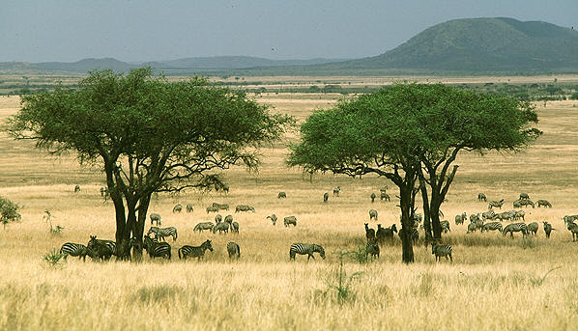
Characteristics
Savanna: warm all year; scattered trees; a dry season (winter) and a wet season (summer monsoon rains)

Slide 7
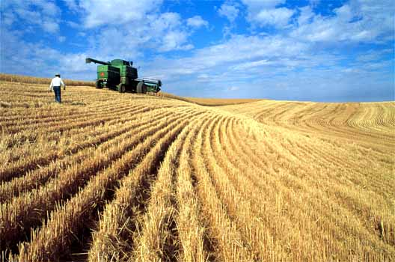
Characteristics
Tall grass grasslands: warm, humid, more rain
Short grass grasslands: dry with cold winters and hot summers
Fertile soil: grasslands have been turned into farms; they have
become the
“breadbaskets”
of the earth

Slide 8
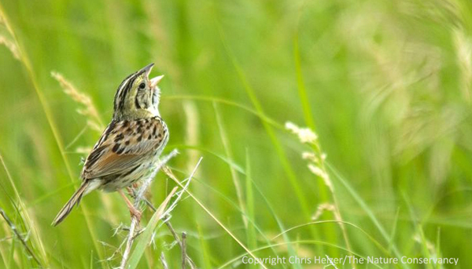
Survival: Plant Adaptations
Long roots: reach deep into soil during dry season or periods of drought; stabilize soil and prevents erosion
Taste bitter or have sharp edges: this discourages grazing

Slide 9
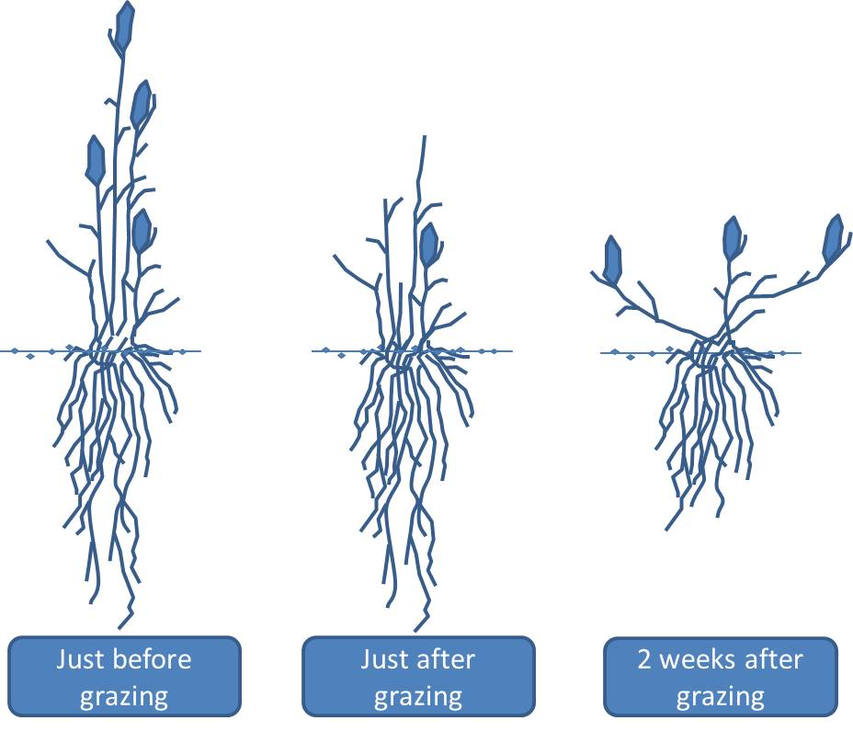
Survival: Plant Adaptations
Grow from bottom up: new growth not damaged by grazing animals
Specialized water storage: some plants store water in trunk or roots
Because grass grows from the
bottom up, it recovers
quickly after grazing

Slide 10
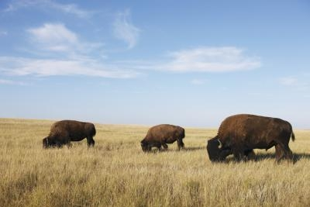
Survival: Animal Adaptations
Home to herds of grazing animals
Migration : animals move to search for water or food
Highly specialized plants and animals to increase biodiversity: animals graze at different heights, prefer different plants, or eat at different times of the day or seasons
A herd of bison
on the Great Plains

Slide 11
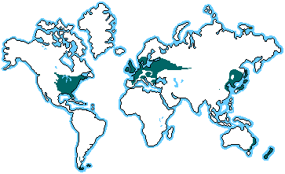
Deciduous Forest: Our Biome
Location

Slide 12
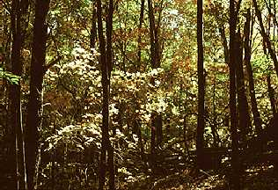
Description
Varies by latitude: -30º C – 30º C (-22º F – 86º F); four distinct seasons
Moderate precipitation: 75-150 cm (30-60 in) precipitation
Deciduous trees: many broadleaf, deciduous trees which lose their leaves in winter; also--shrubs, mosses
This should look familiar—
if you’ve ever walked in
the Georgia woods!

Slide 13
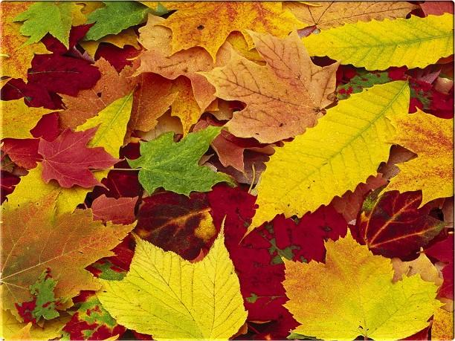
Characteristics
Found in the Eastern United States, Middle of Europe; Japan and China; southeastern Australia; New Zealand
Leaves change color in autumn, fall off in winter, grow back in spring
Rich soil: fertilized by
leaf litter each year

Slide 14
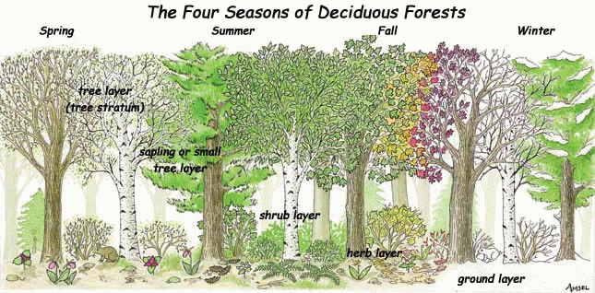
Characteristics
Many deciduous forests have been lost: they were cleared for farmland
The Tree canopy allows some light to penetrate: this produces a rich diversity of understory plants and animals

Slide 15
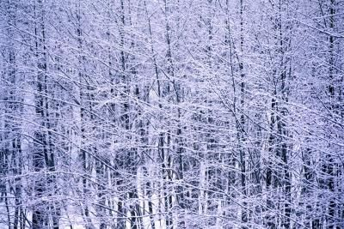
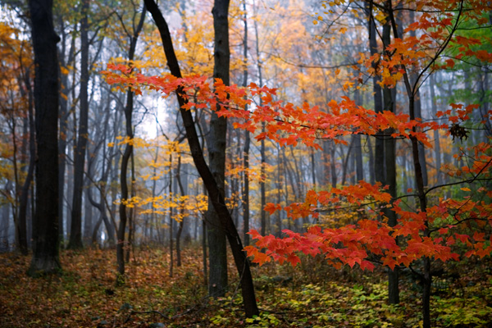
Survival: Plant Adaptations
Thick bark: protects against cold
Period of dormancy or sleep: trees lose leaves and “hibernate” during winter
Fall and Winter in the
Deciduous Forest

Slide 16
Survival : Animal Adaptations
Home to many animals
Hibernation: winters are cold, so many animals hibernate
Many omnivores or nut and acorn feeders

