Slide 1
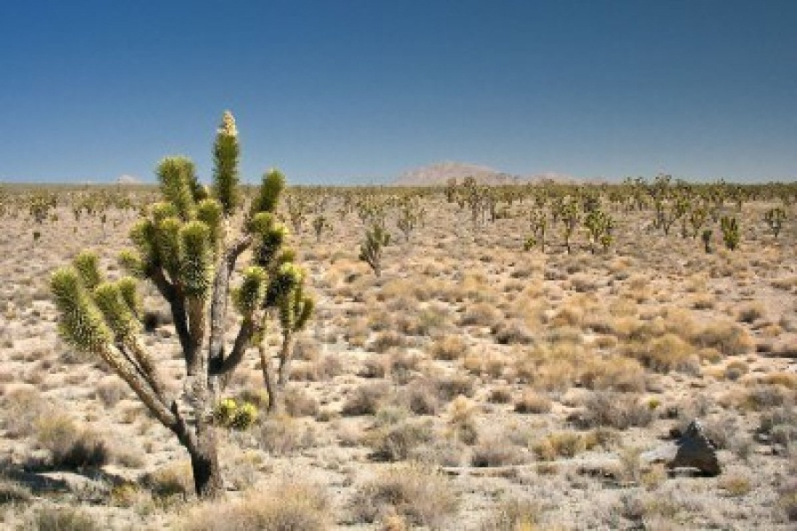
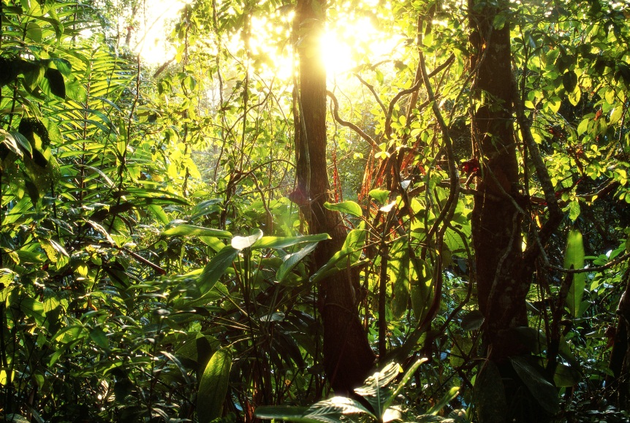
Terrestrial Biomes Features and Creatures
Deserts
Rainforests

Slide 2
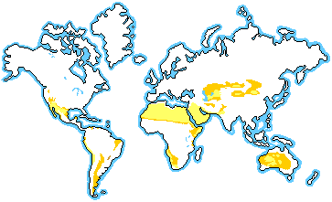
Deserts
Location

Slide 3
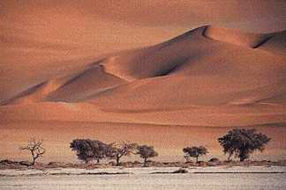
Description
Large temperature swings from day to night : 38º C to -4º C (100º F – 25º F)
Dry or arid: 25 cm (10 in) precipitation
Hot deserts: precipitation falls as rain; Mojave, Saharan
Cold deserts: precipitation falls as snow; Antarctica
Can you name this desert?
HINT: It is located in northern Africa!

Slide 4
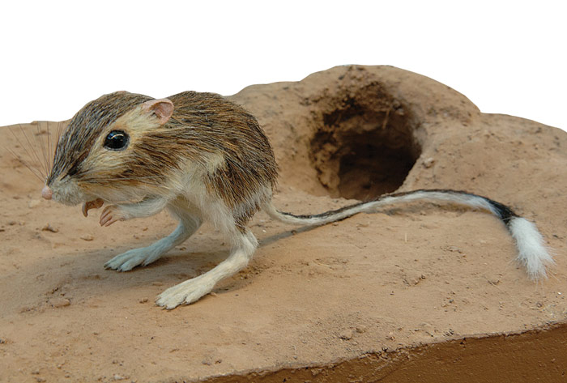
Characteristics
Driest biome
Deserts cover about 1/5 of the earth’s surface
Specialized plants and animals live in this biome
The kangaroo rat eats mostly
seeds. It forages for food at night,
when the temperature is cooler.
Where does this animal spend its days?

Slide 5
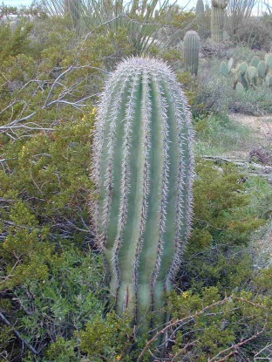
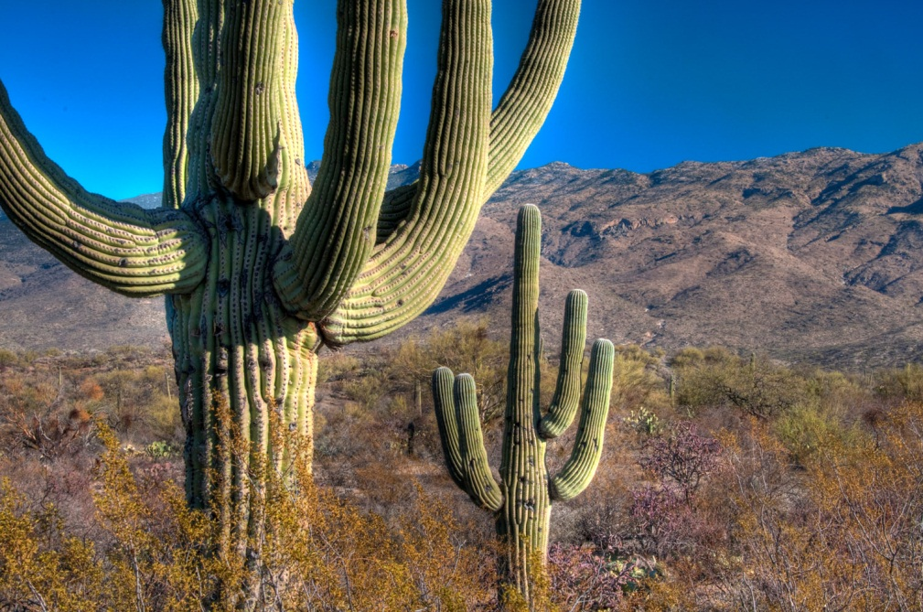
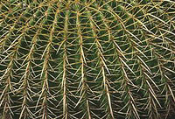
Survival: Plant Adaptations
Water storage: in stems or roots
Thick, waxy cuticle: prevents dehydration
“Pleated stems”: expand to store water
The “pleats” of these cacti
expand to store water

Slide 6
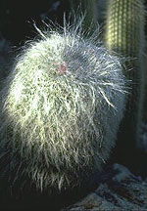
Survival: Plant Adaptations
Period of dormancy: plants stop growing during dry spells
Long taproots or large root system: these roots gather water deep in the soil or quickly after a rain
Few or no leaves: this prevents dehydration; stems are green for photosynthesis
Thorns or spiny leaves: reflect light,
and prevent animals from eating
Spiny thorns reflect sunlight and
discourage animals from snacking!

Slide 7
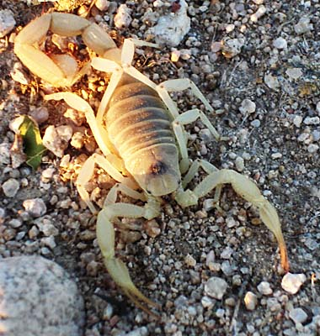
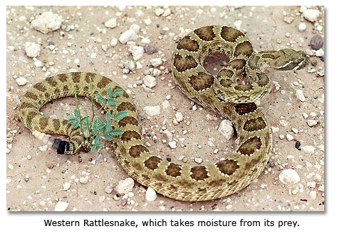
Survival: animal Adaptations
Few large mammals; little shelter from sun
Many reptiles
Many nocturnal animals
Many burrowing animals

Slide 8
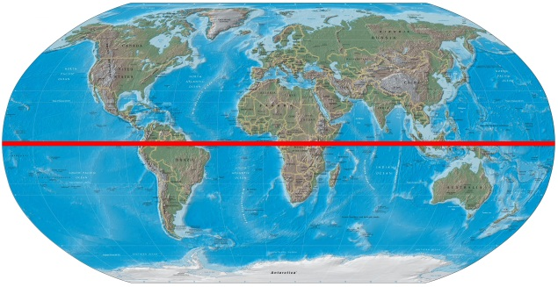
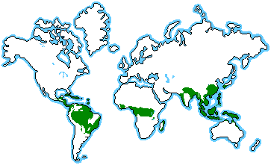
Rainforest
Location
These rainforests all lie very close to what imaginary line?

Slide 9
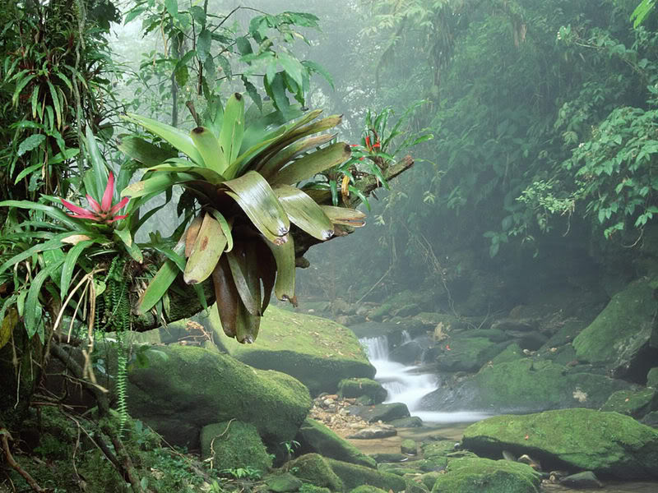
Description
Very warm: 20º C to 34º C (68º F – º 93F)
Humid and Wet: 200-1000 cm (80 to more than 100 in) rain; rains year round
Tropical rainforest: close to equator; remains frost-free
Temperate rainforest: cooler,
Located near coasts
A tropical rainforest

Slide 10
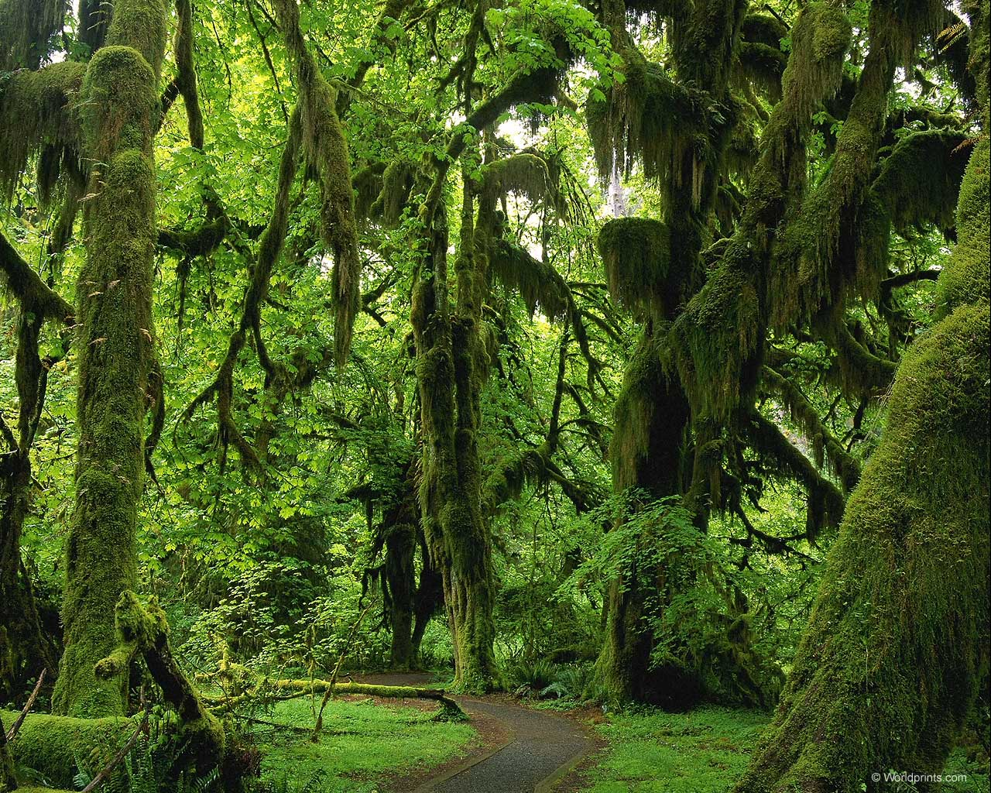
A Temperate Rainforest
The Hoh rainforest is located on the west coast of Washington (the state, not D.C.)
Any Twilight fans out there? This is near the very real town of Forks!

Slide 11
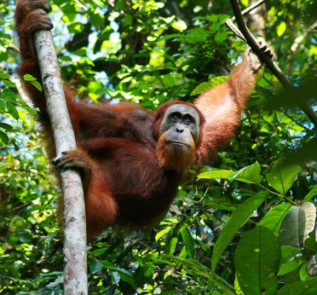
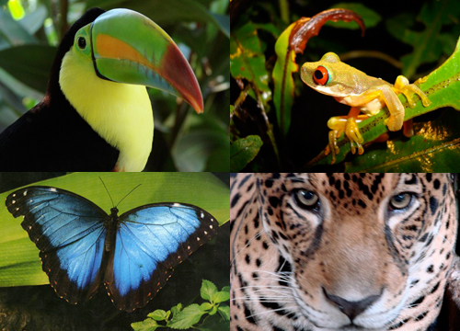
Characteristics
Most diverse biome
Cover about 6% of earth’s surface
¼ of all medicines come from rainforest plants

Slide 12
Four main Layers
Emergent layer: very tall, widely spaced trees with umbrella-shaped canopies; lots of intense light
Upper canopy: tall trees that allow little light to penetrate; many vines; most animals live here
Understory or Lower Canopy: smaller trees, ferns , vines, and palms; little light, little air movement & high humidity
Forest floor: few plants because of deep shade; poor soil (nutrients quickly decomposed and absorbed by tree roots)

Slide 13
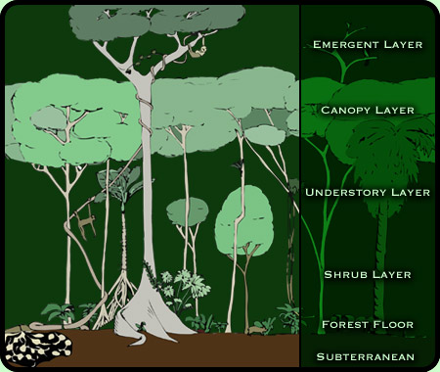
Rainforest Layers
http://www.thewildclassroom.com/biomes/rainforest.html

Slide 14
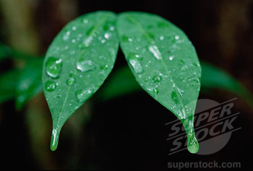
Survival: Plant Adaptations
Drip tips and grooved leaves: these help shed water from leaves to prevent rotting
Oily coatings: this also helps shed water from leaves to prevent rotting
Small, leathery leaves in Upper canopy: these leaves protect from dehydration in the intense sun
Large leaves in Lower canopy: these leaves help understory plants absorb light in the shade
Drip tips help shed water

Slide 15
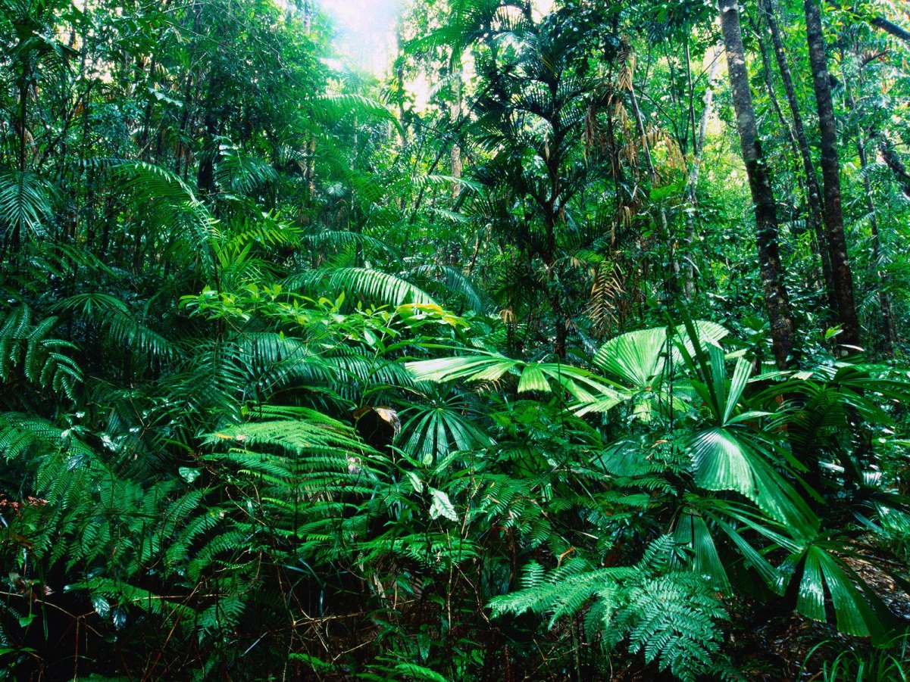
Survival: Plant adaptations
Notice the large-leaved
Plants in the understory.
What is the advantage of
Having large leaves in this layer?

Slide 16
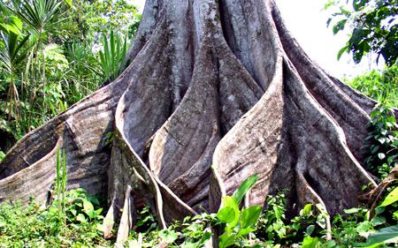
Survival: Plant Adaptations
Leaf stalks that turn to follow the sun: maximize light in the understory
Epiphytes (plants that grow on other plants) grow in upper canopy; orchids and bromeliads
Buttress or Stilt roots: anchor in shallow, wet soil
Many vines
Buttress roots:
Why are these common
in the rainforest? How do they
Provide an advantage?

Slide 17
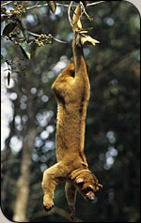
Survival: animal Adaptations
Prehensile tails: a tail used to help climb
Bright colors: blend with the brightly colored flowers
Many insects live
in the rainforest
Many fruit-eating animals
This kinkajou is using a prehensile tail!
http://www.amnh.org/education/resources/rfl/web/extrememammalsguide/glossary.html

Slide 18
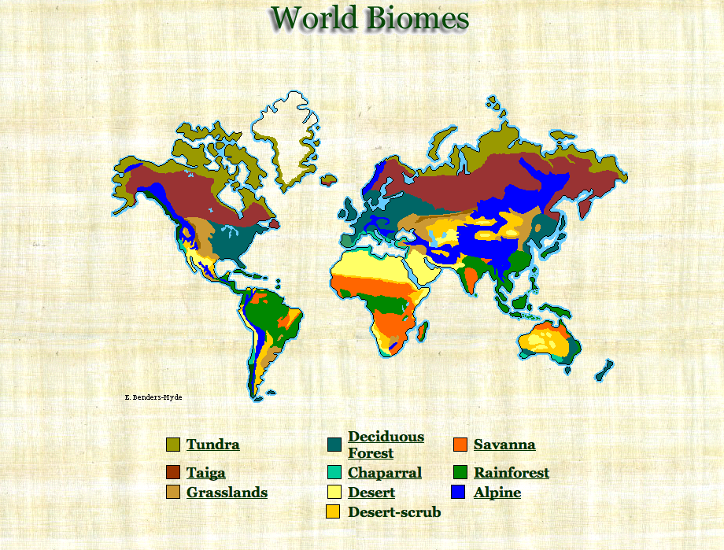
This concludes our tour of six terrestrial biomes!
We toured Tundra, Taiga, Grasslands, Deciduous Forests, Deserts, and Rainforests!

